Slide 1
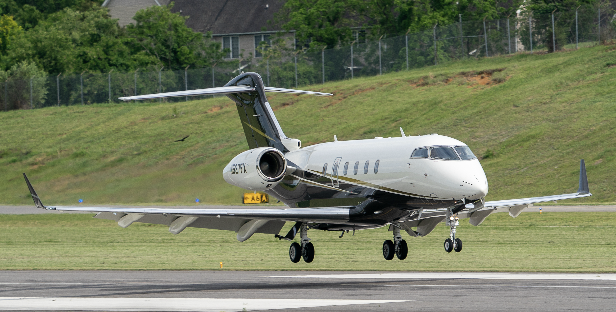
Small Aircraft Runway Length Analysis Tool Quick User Guide (version 2.0.0.8)
N. Hinze, Z. Wang, H. Swingle, A. Olamai,
A. Zolfaghari, A. Trani
Air Transportation Systems Laboratory
Virginia Tech
July 18, 2024

Slide 2
Table of Contents
Installation instructions
Using the Small Aircraft Runway Length Analysis Tool - SARLAT
General information about SARLAT
SARLAT 2 Interface and analysis options
Runway evaluation mode
Runway design mode
Runway evaluation validation plots
Runway design validation plots
Aircraft stage length analysis
Aircraft range and useful load data
Saving and exporting data in SARLAT 2
Critical aircraft considering runway length
Case studies

Slide 3
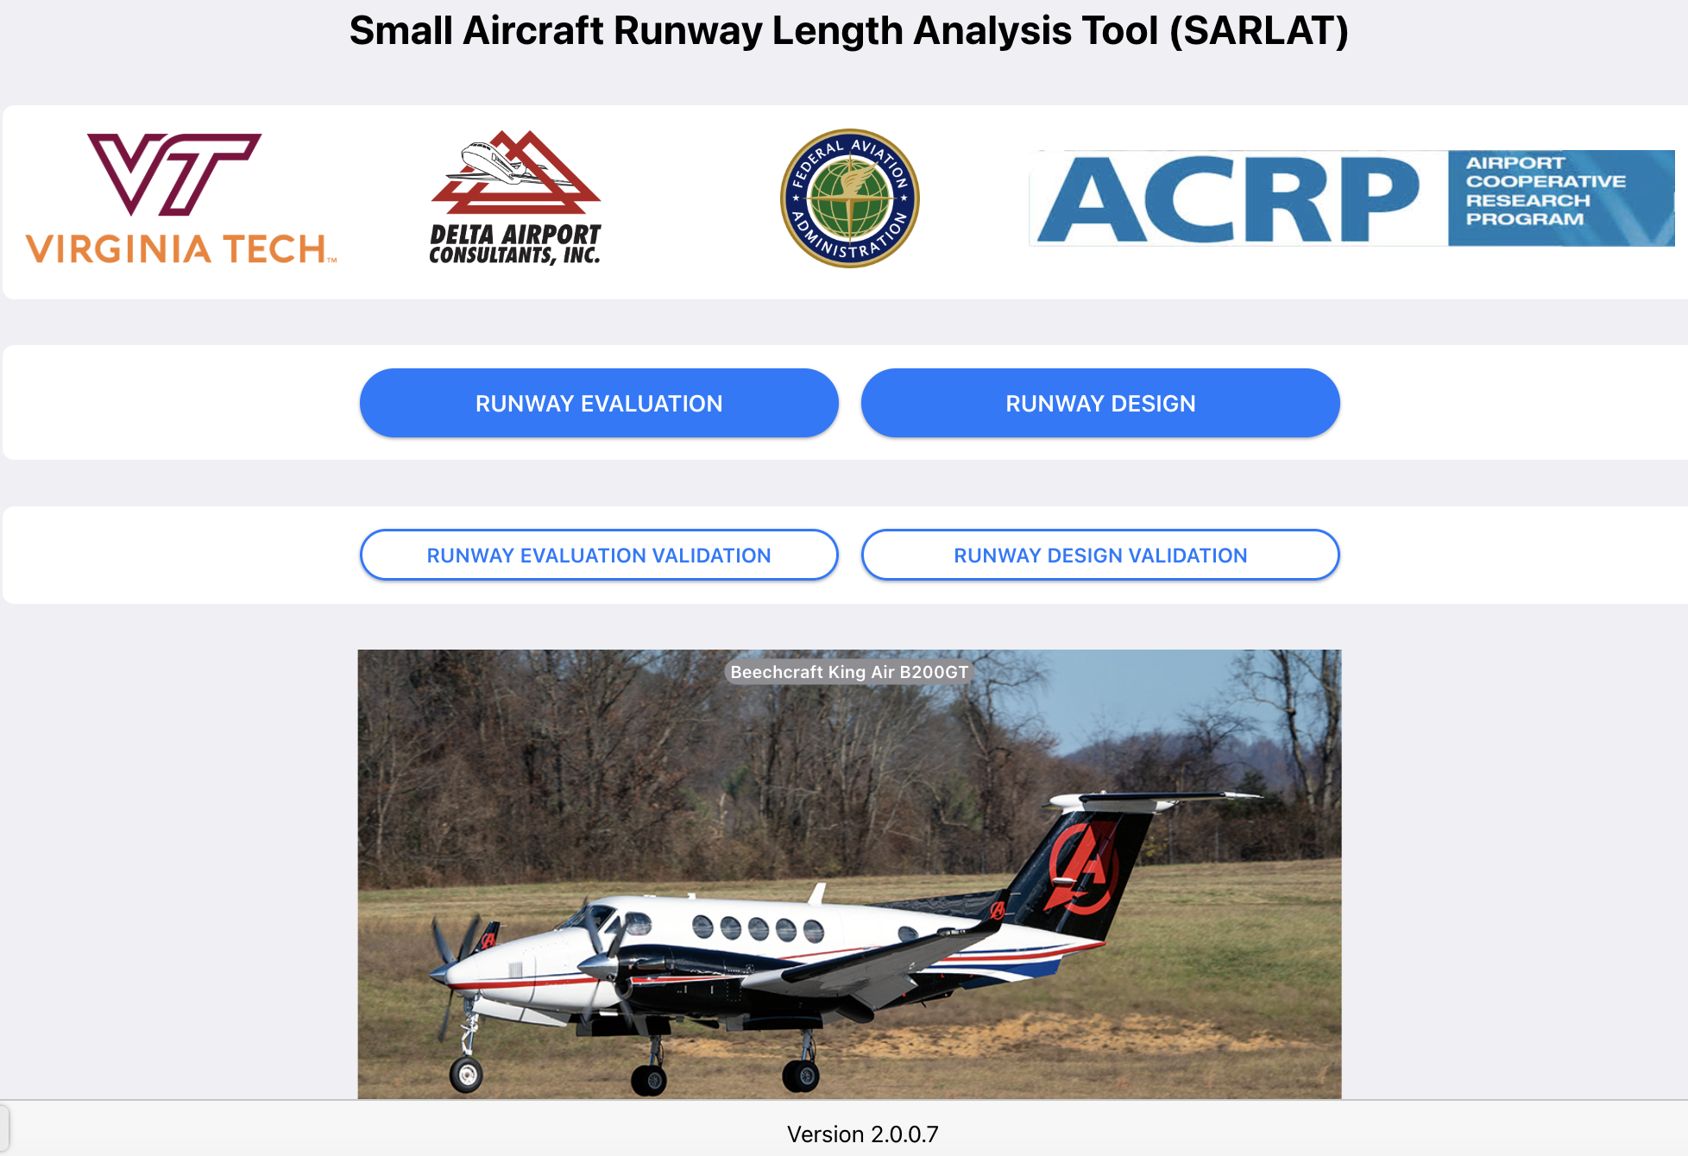
Small Aircraft Runway Length Analysis Tool
Installation Instructions
Go to Table of Contents

Slide 4
Installation Instructions for Windows OS
Go to Table of Contents
Step 1: Download the Small Aircraft Runway Length Analysis Tool (SARLAT) setup file from:
Step 2: Locate the downloaded file on your hard drive folder
SARLAT+2-2.0.0+Setup.exe
Step 3: Install the application
Double click on the SARLAT+2-2.0.0+Setup.exe file
Windows: https://atsl-software-downloads.s3.amazonaws.com/sarlat/V2.0.0/SARLAT+2-2.0.0+Setup.exe
Note: In Windows you do not need to have Administration privileges to install SARLAT

Slide 5
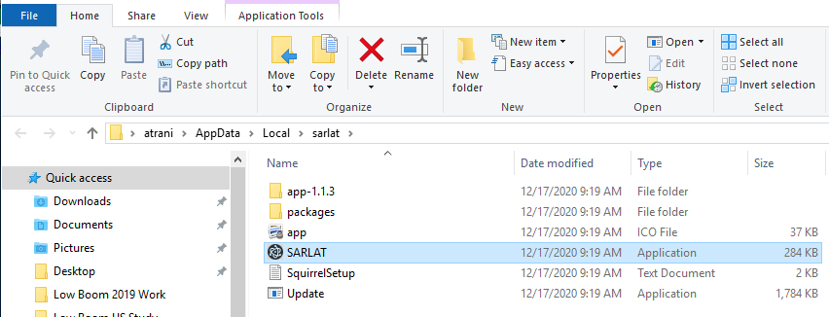
SARLAT Installation Files in Windows OS
Go to Table of Contents
SARLAT is usually installed in your local drive under the name SARLAT
The example shows SARLAT installed in the user/AppData/local folder

Slide 6
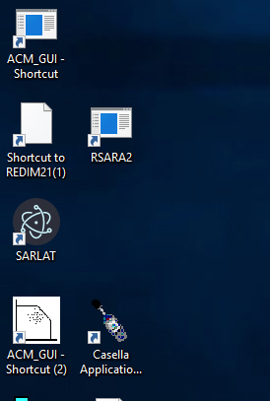
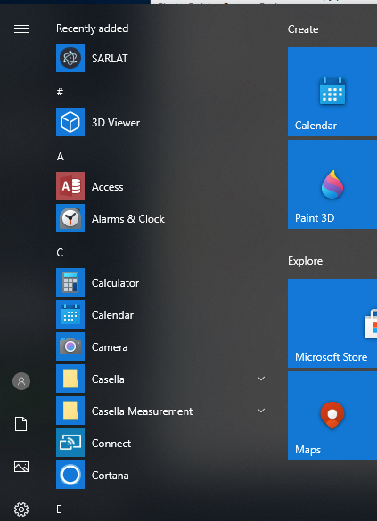
Running the Small Aircraft Runway Length Analysis Tool in Windows after Installation
Go to Table of Contents
After installation, SARLAT creates an icon on the desktop automatically
To run the application again, use the icon on the desktop
SARLAT can be executed from the Applications Panel in Windows
Small Aircraft Runway Length Analysis Tool
Application icon installed on the Desktop

Slide 7
Installation Instructions for Mac OS
Go to Table of Contents
Step 1: Download the Small Aircraft Runway Length Analysis Tool (SARLAT) setup file from:
Step 2: Locate the downloaded file on your hard drive folder. The file is an Apple Disk Image file called SARLAT-2.0.0.dmg
Step 3: Install the application
Double click on the SARLAT-2.0.0.dmg file on the Mac OS
Mac Intel Processors: https://atsl-software-downloads.s3.amazonaws.com/sarlat/V2.0.0/SARLAT+2-2.0.0-x64.dmg
Mac ARM Processors: https://atsl-software-downloads.s3.amazonaws.com/sarlat/V2.0.0/SARLAT+2-2.0.0-arm64.dmg

Slide 8
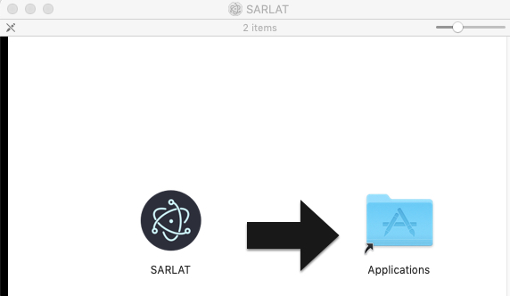
Installation Instructions for Mac OS (2)
Go to Table of Contents
Step 4: Drag the SARLAT application icon to your Applications Folder
Step 5: Click Open in the security warning allowing the SARLAT application to run in your computer
Step 6: If necessary, allow the SARLAT application dialog in the Security & Privacy inside the Systems Preferences

Slide 9
Running the Small Aircraft Runway Length Analysis Tool in Mac OS after Installation
Go to Table of Contents
After installation, the SARLAT Application resides in the Applications Folder in your computer
Double click in there SARLAT icon to run the application
You can create a shortcut by dragging the SARLAT Application icon to the computer task bar
SARLAT Application Icon

Slide 10
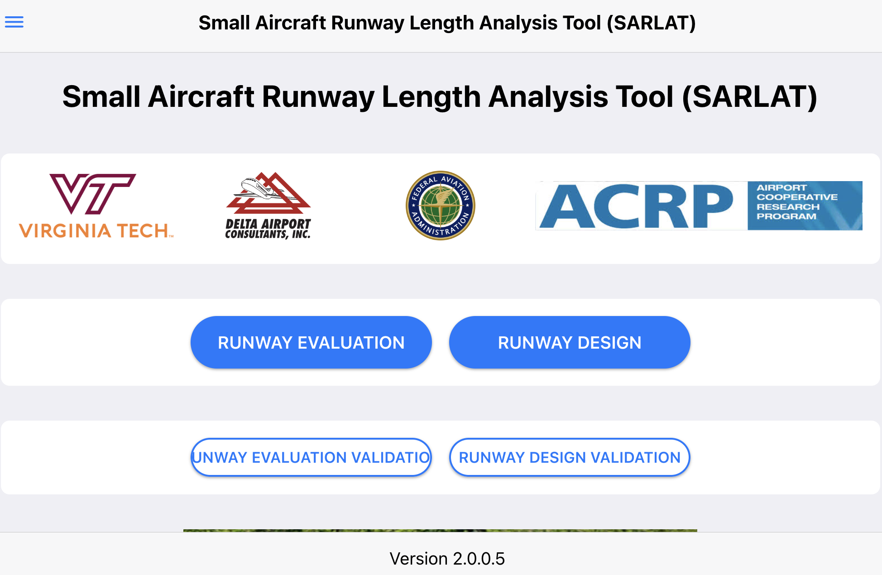
Small Aircraft Runway Length Analysis Tool
Go to Table of Contents
Functionality of the model is the same for both Windows and Mac OS users
Tool is programmed using Javascript and Hypertext Markup Language (HTML)
SARLAT does not require a connection to the Internet or a server
Mac OS 14.5 Operating System
Windows 11 Operating System

Slide 11
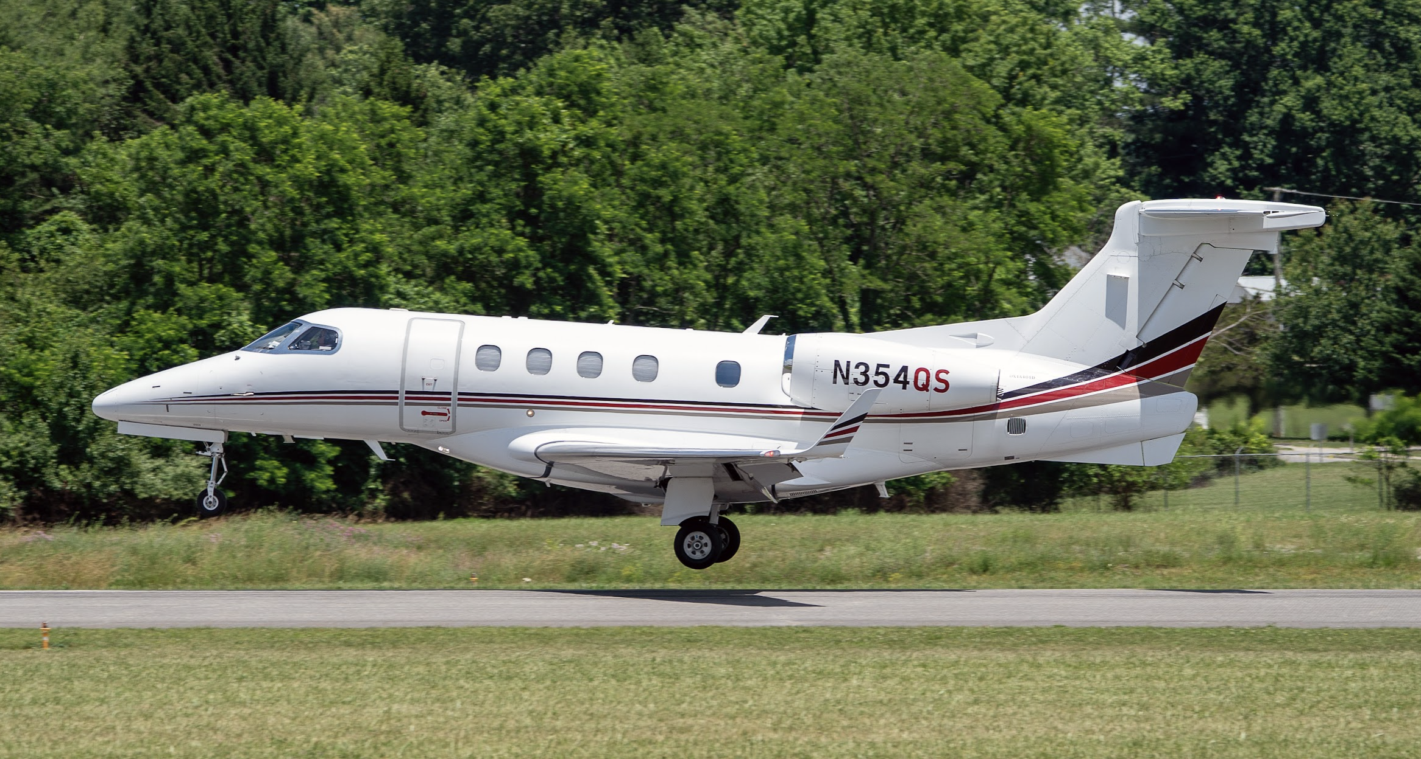
Using the Small Aircraft Runway Length Analysis Tool
Go to Table of Contents

Slide 12
General Information About the Model
Go to Table of Contents
The Small Aircraft Runway Length Analysis Tool estimates takeoff and landing distances for 67 aircraft (more to be added later)
The information presented in the tool has been collected, analyzed and validated from aircraft flight manuals, pilot operating handbooks, and flight planning guides
SARLAT 2 includes mission profiles and useful load-range diagrams for aircraft weighting more than 12,500 lbs. and for all turbofan-powered aircraft.

Slide 13
SARLAT 2 Takeoff Runway Length Reports
Go to Table of Contents
For turbofan and turboprop aircraft weighing 12,500 lbs. or more, SARLAT 2 reports Takeoff Field Length
For turboprop aircraft weighing less than 12,500 lbs. and piston-powered twin-engine aircraft we report Takeoff Distance to Clear a 50-foot Obstacle
For single engine piston-powered aircraft, we report Takeoff Distance to Clear a 50-foot Obstacle
For AIP projects, use dry takeoff and wet landing performance charts.

Slide 14
SARLAT 2 Landing Runway Length Reports
Go to Table of Contents
For all types of aircraft, we report uncorrected dry pavement landing distance
For all types of aircraft, we report wet pavement landing distance (dry landing distance corrected)
For turbofan-powered aircraft operating under 14 CFR Part 135 rules, we report corrected dry pavement landing distance (1.67 times the uncorrected dry landing distance)
For turbofan-powered aircraft operating under 14 CFR Part 135 rules, we report corrected wet pavement landing distance (1.92 times the uncorrected dry landing distance)
For turboprop-powered aircraft operating under 14 CFR Part 135 rules, we report corrected dry pavement landing distance (1.43 times the uncorrected dry landing distance)

Slide 15
SARLAT 2 Runway Length Analysis Limits
Go to Table of Contents
Parameter | Lower Limit | Upper Limit | Remarks
Temperature (deg. Fahrenheit) | Limited by aircraft manufacturer data | Limited by aircraft manufacturer data | Jet powered aircraft reported to 40-50 degrees. C.
Pressure Altitude (feet) | 0 | None | Most aircraft performance data is reported to 8,000 feet altitude. For many jets the data covers up to 12,000 feet.
Wind (knots) | -10 | 5 | Headwind is negative
Runway Gradient (%) | 0 | 2 | Assumes both runway ends of the runway are used (uphill is positive)
Runway Surface Conditions | Dry, Wet, Grass*, and Gravel*
SARLAT data sources are Pilot Operating Handbooks, Aircraft Flight Manuals, and Flight Planning Guides

Slide 16
Small Aircraft Runway Length Analysis Tool Menu Structure and Interface
Go to Table of Contents
Step 1: Expand the left side
viewport anytime to access
all Small Aircraft Runway
Length Analysis Tool analysis
methods
Alternate Method: Select one
of the four methods in the Home
screen of the Small Aircraft Runway
Length Analysis Tool

Slide 17
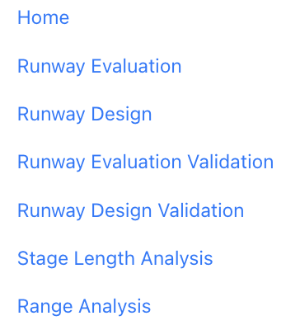
SARLAT 2 Model Analysis Options
Go to Table of Contents
The Small Aircraft Runway Length Analysis Tool has three areas described below:
Analysis modes:
a) Evaluation of an existing runway
b) Design of a new runway
Validation modes:
a) Evaluation of an existing runway plots
b) Design of a new runway plots
Mission Analysis:
a) Stage length analysis
b) Useful load-range analysis
Use the Analysis Modes to evaluate or design a new runway
Use the Validation Modes to validate and visualize the runway performance of individual aircraft for a set of airport conditions

Slide 18
Runway Evaluation Mode
Objective: Determine if a group of aircraft can safely operate from an existing runway
Go to Table of Contents

Slide 19
Runway Evaluation Mode
Go to Table of Contents
Objective:
To evaluate if a given aircraft fleet can operate an existing airport
Output Produced
Suitability of each aircraft to operate at the airport
Takeoff distances (dry and wet)
Landing distances (dry, wet, Part 135 dry, and Part 135 wet)
Aircraft useful load for the given runway length available and airport conditions
Range profiles that can be flown with the runway available

Slide 20
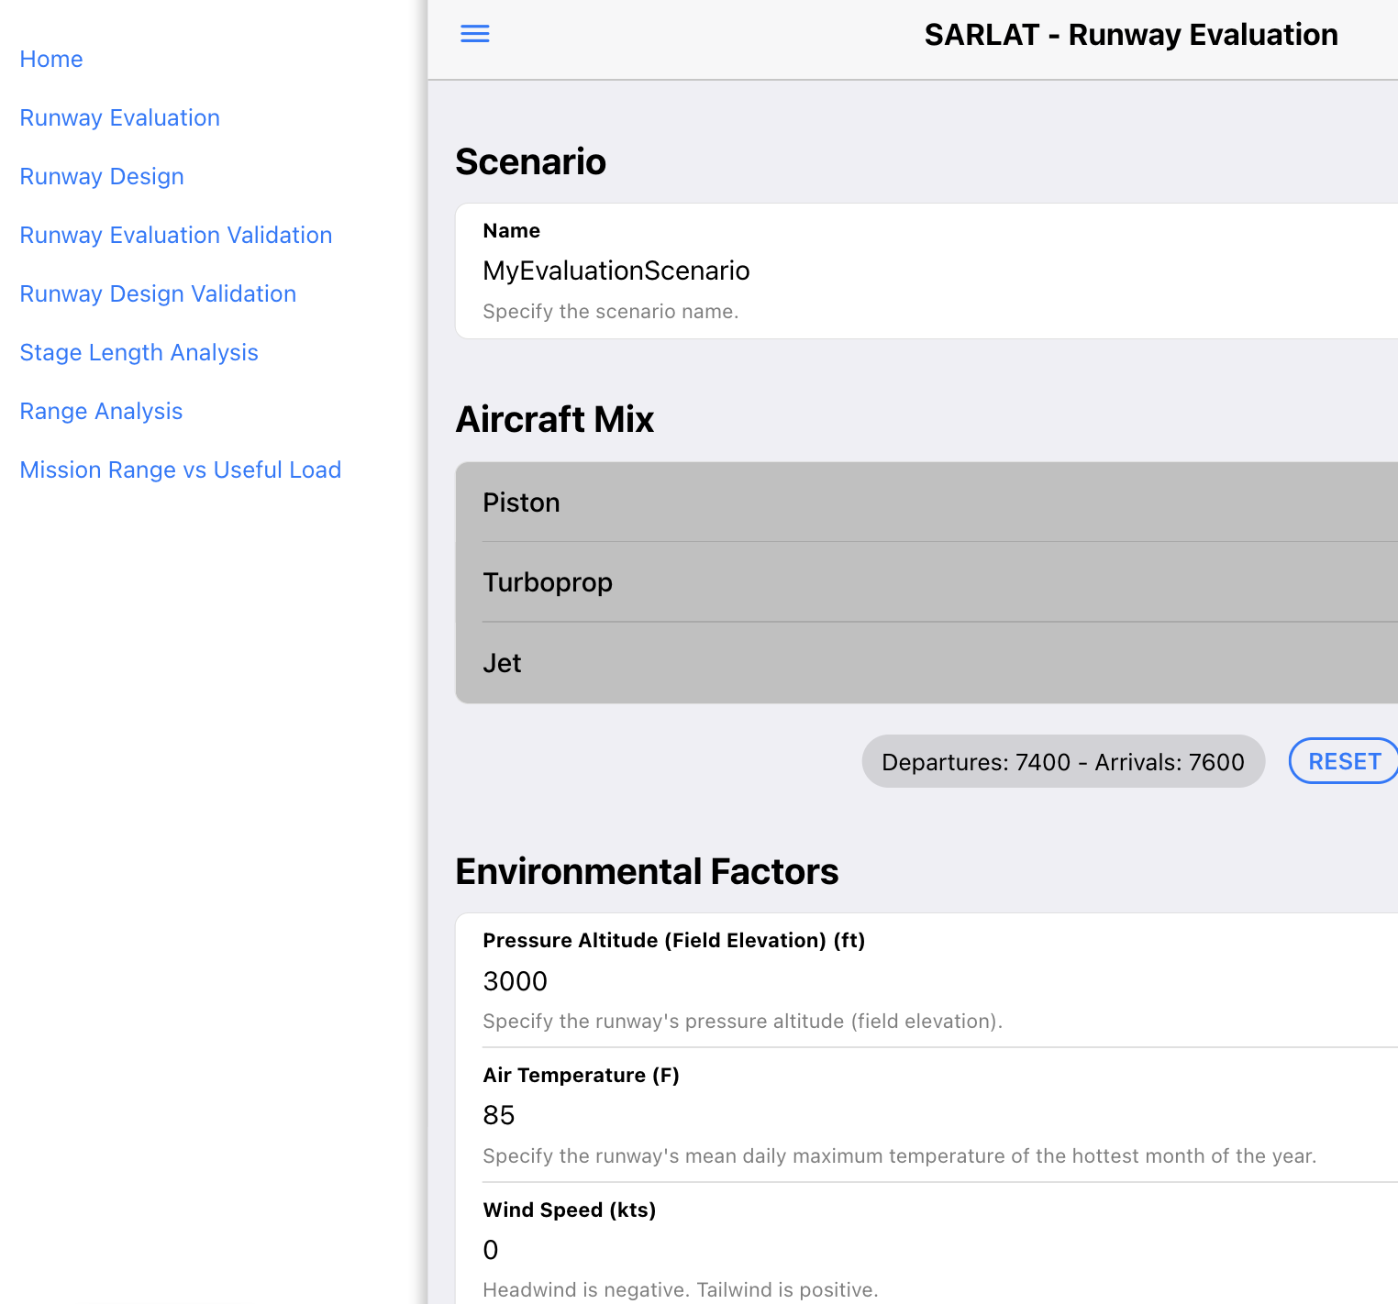
Runway Evaluation Mode Interface
Go to Table of Contents
Step 1: Select Runway
Evaluation mode
Step 2: Select a scenario
name
Step 3: Select the aircraft using
the airport and enter the fleet
mix (expandable list)
Step 4: Enter the airport
environmental conditions

Slide 21
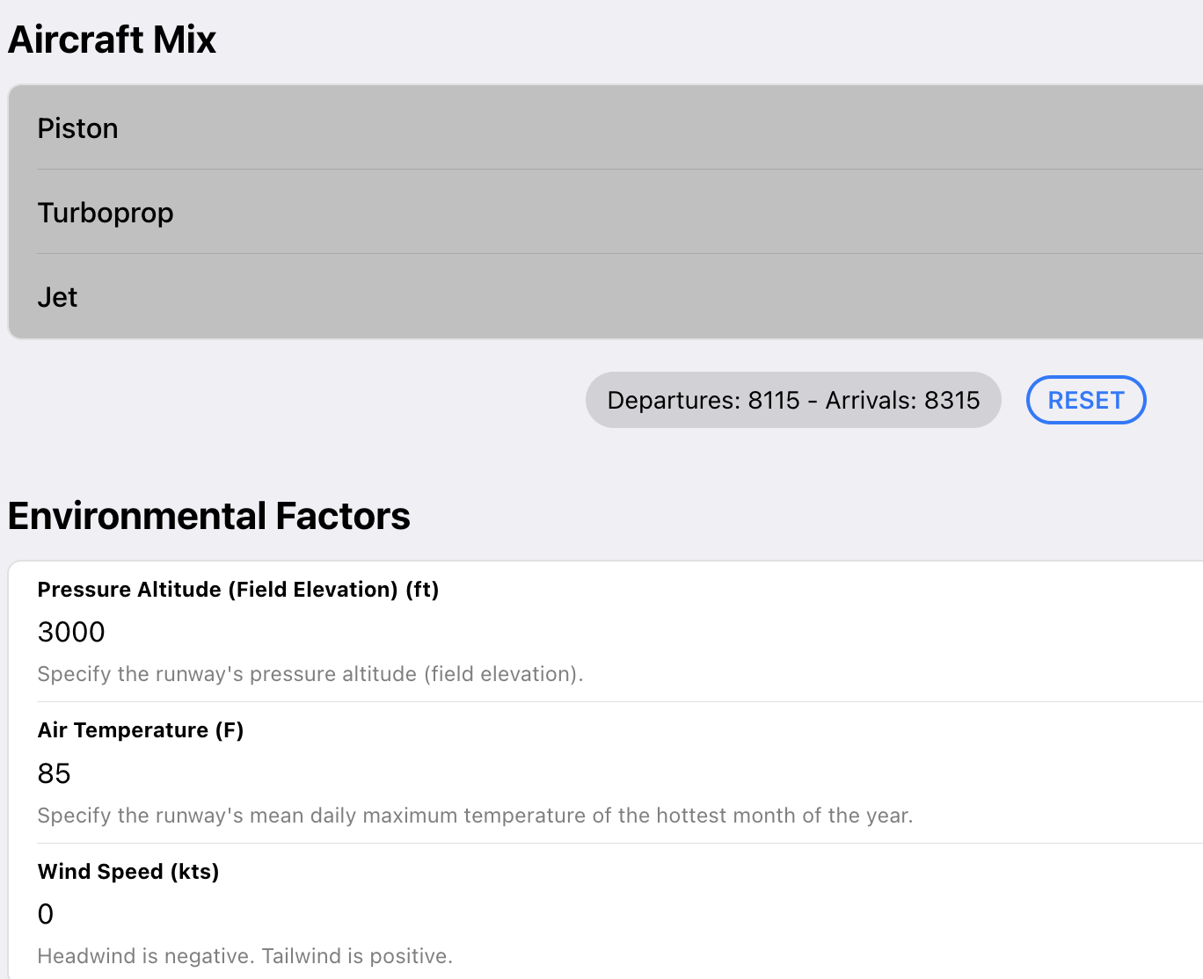
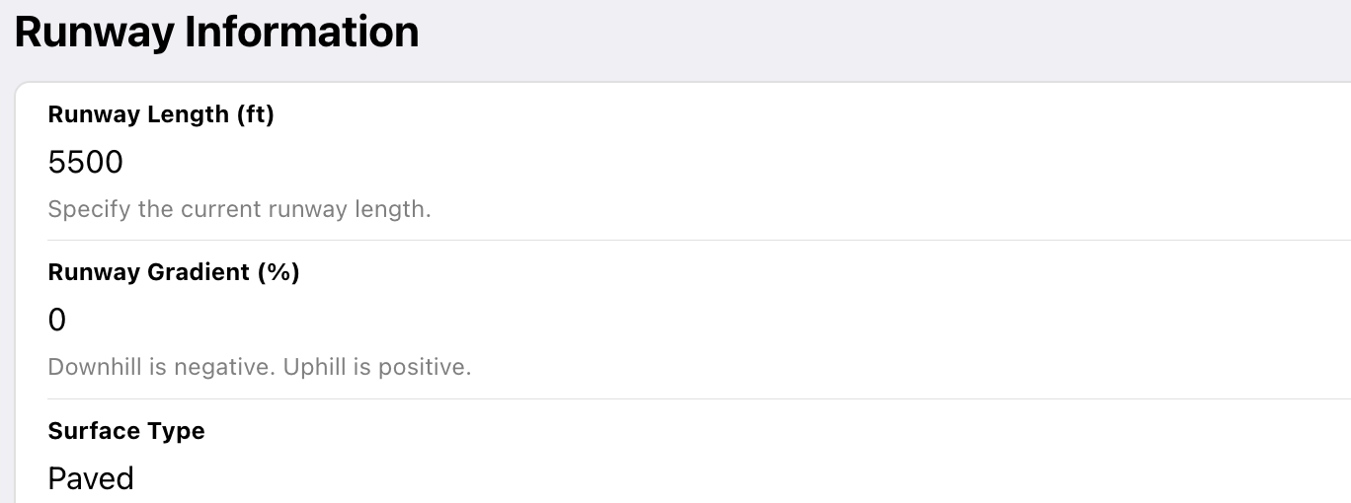
Runway Evaluation Mode Interface (2)
Go to Table of Contents
Step 3: Select the aircraft using
the airport and enter the fleet
mix (expandable list)
Step 4: Enter the airport
environmental conditions
Step 5: Enter the runway
information
Step 6: Run the case

Slide 22
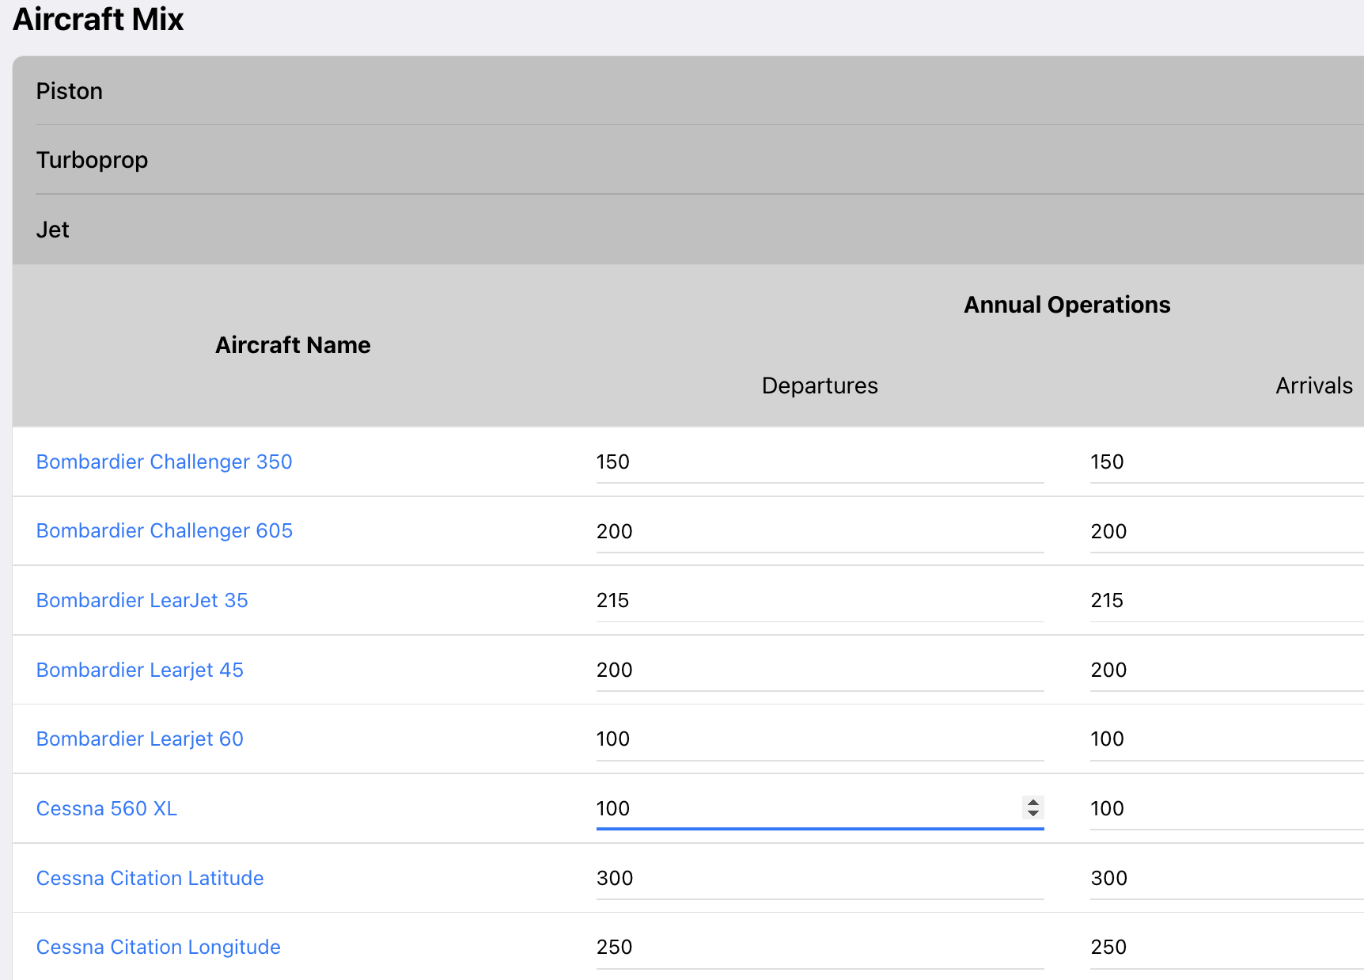
Runway Evaluation Mode: Aircraft Fleet Mix
Go to Table of Contents
Select the aircraft fleet mix
and expand each one of
three engine groups
Jet aircraft group
expanded

Slide 23
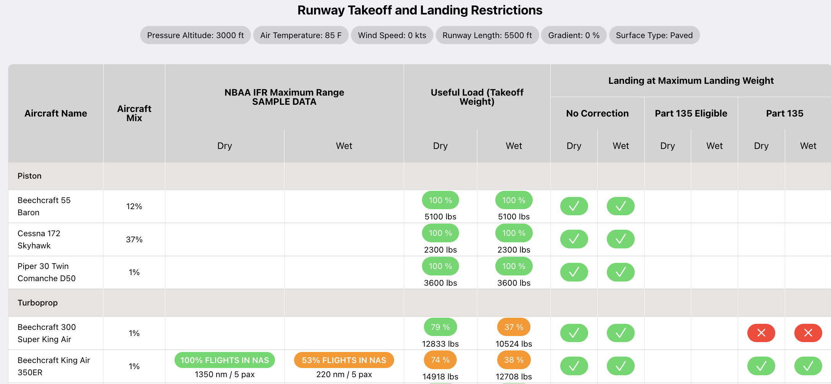
Runway Evaluation Output Interface
Go to Table of Contents
Evaluation
Conditions
Pressure altitude = 3,000 feet
Runway length = 5,500 feet
Design temperature = 85 deg. F.
Runway gradient = 0.0%
Surface = paved
Runway Evaluation Conditions
Landing Suitability Table
Includes 14 CFR Part 135 Landing Checks
Takeoff Weights and Useful Load Constraints

Slide 24
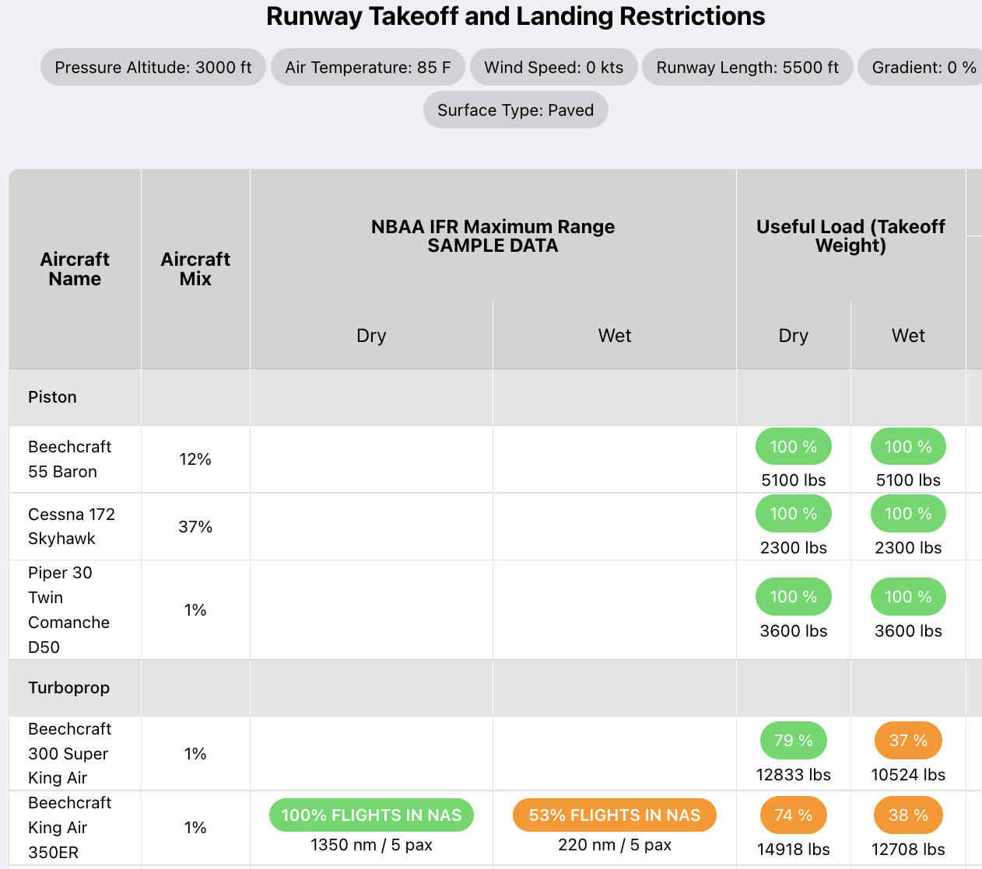
Runway Evaluation Output Interface
Go to Table of Contents
Evaluation
Conditions
Pressure altitude = 3,000 feet
Runway length = 5,500 feet
Design temperature = 85 deg. F.
Runway gradient = 0.0%
Surface = paved
Provides the operational weight restrictions for each aircraft
Aircraft useful load and mission range are reported as output
Runway Evaluation Conditions
The Beechcraft Baron 58 can operate from the 5500-foot runway at 100% useful load
The Beechcraft King Air 350ER can operate from the 5500-foot runway at 74% useful load in dry runway conditions.

Slide 25
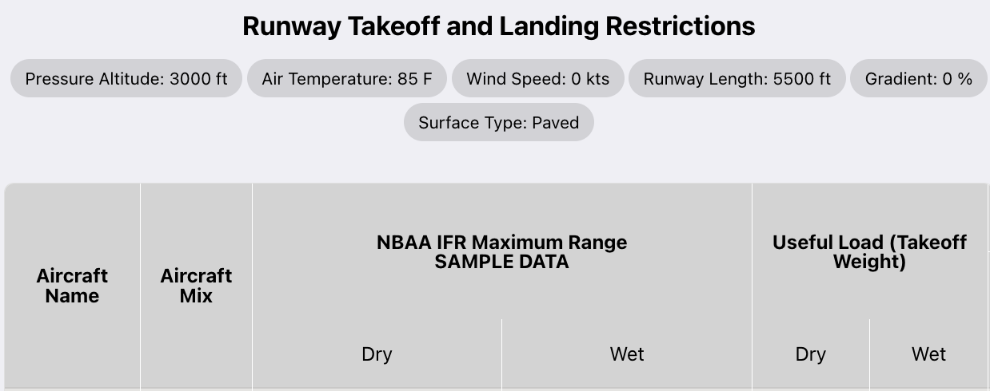
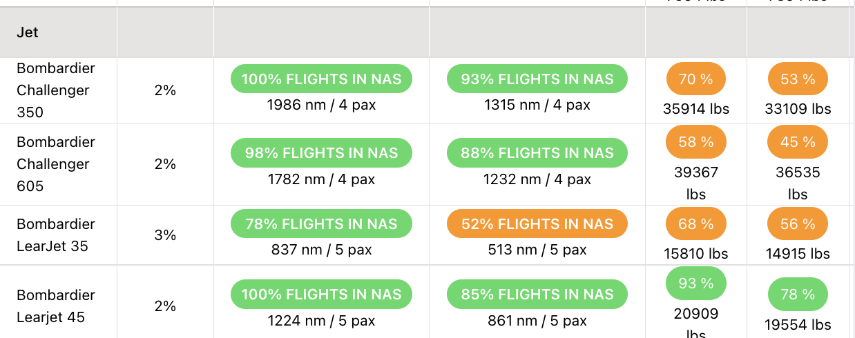
Runway Evaluation Output Interface
Go to Table of Contents
Evaluation
Conditions
Pressure altitude = 3,000 feet
Runway length = 5,500 feet
Design temperature = 85 deg. F.
Runway gradient = 0.0%
Surface = paved
Aircraft useful load and mission range are reported as output
Runway Evaluation Conditions
The Bombardier Challenger 350 can operate from the runway at 70% useful load (dry runway conditions)
The Bombardier Learjet 45 can operate at 78% useful load in wet runway conditions. The Learjet 45 can fly 861 nm with five passengers plus two pilots from the 5500-foot runway (wet pavement conditions).

Slide 26
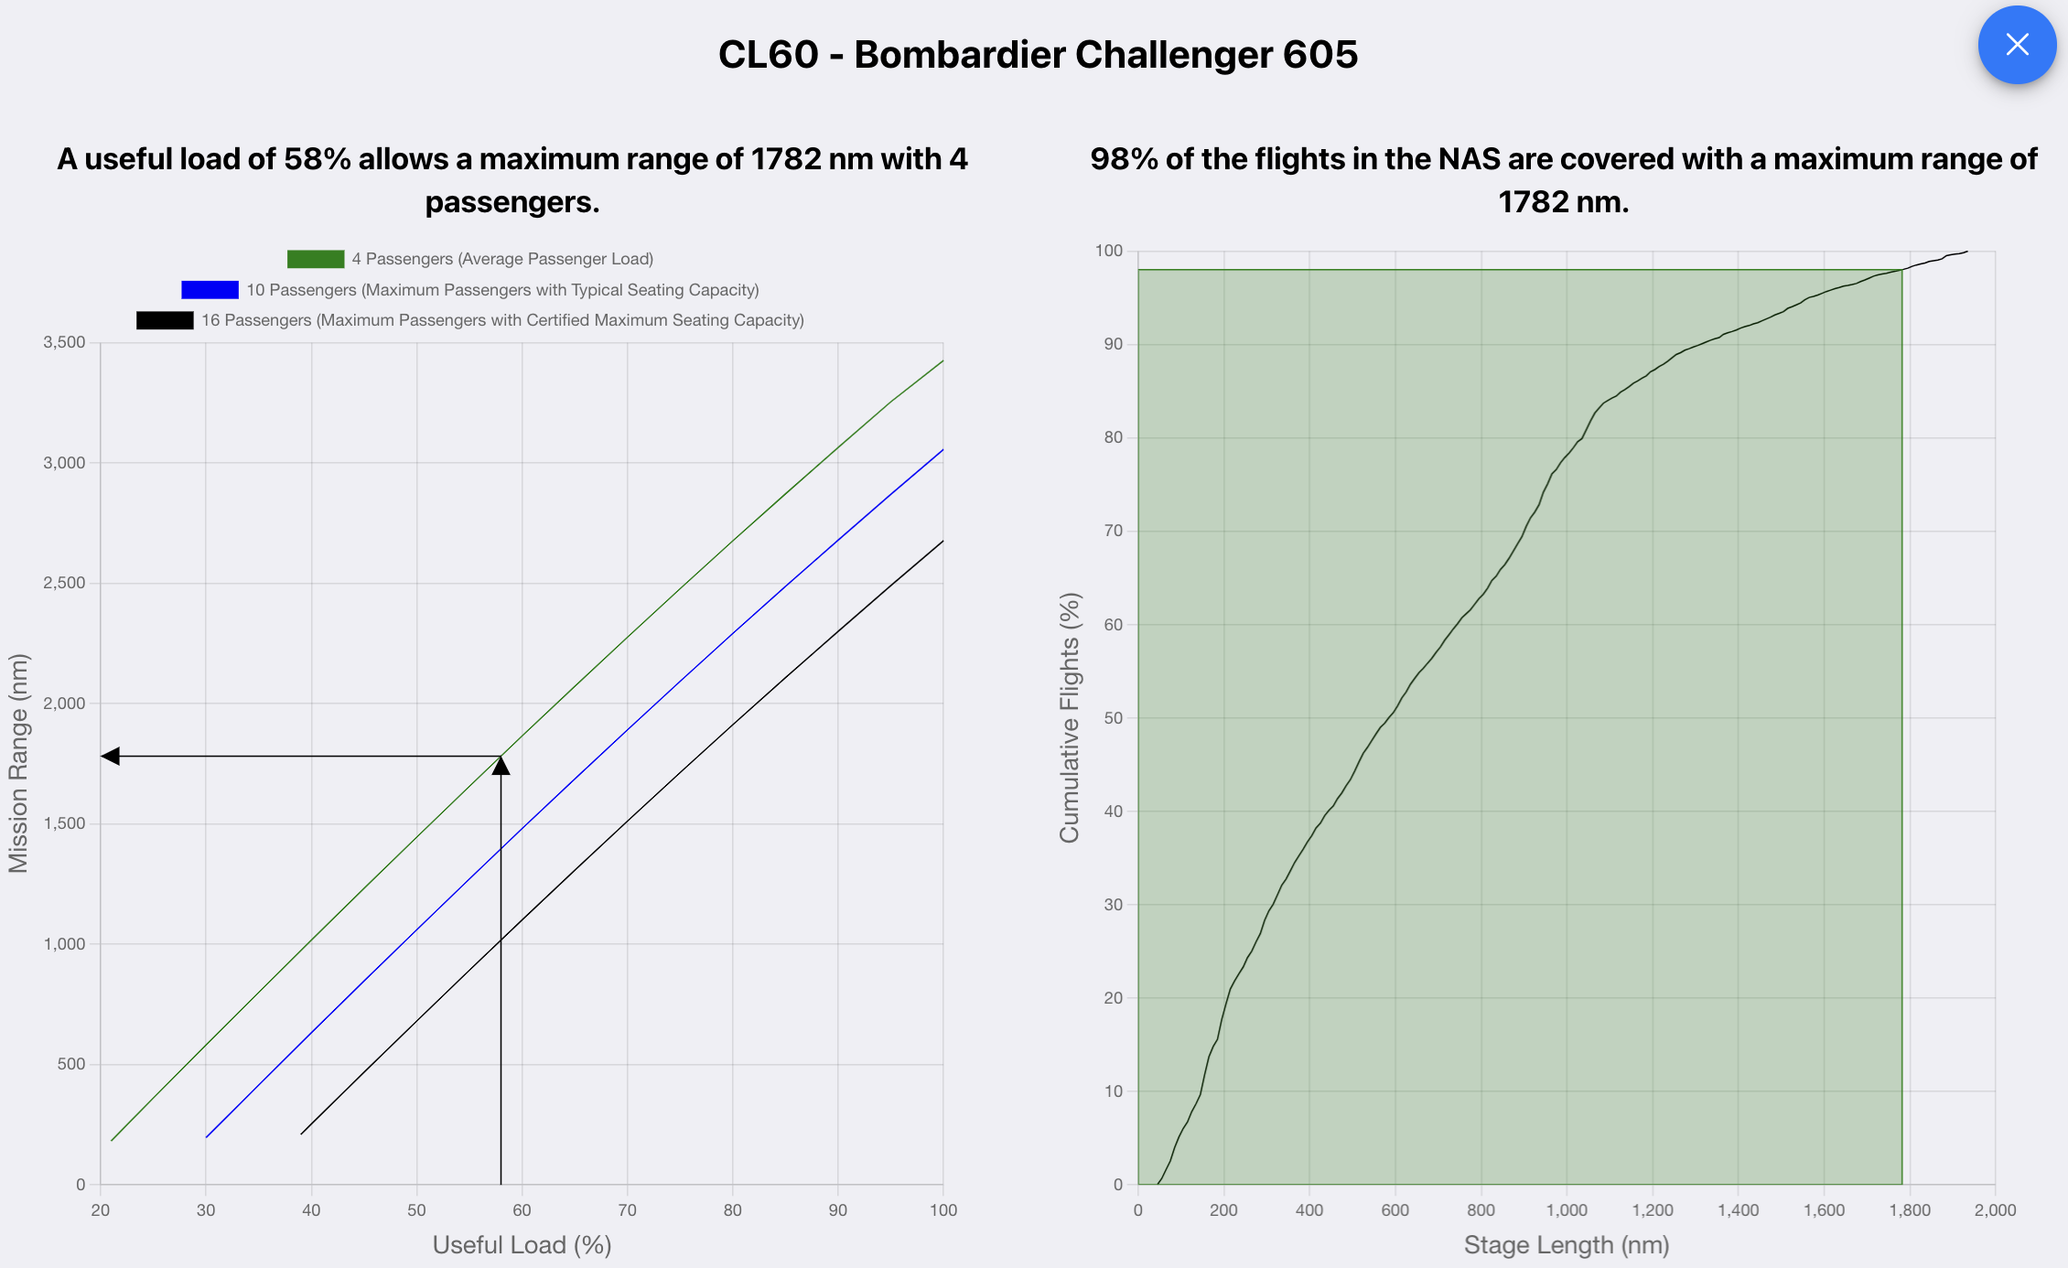
Go to Table of Contents
Evaluation Mode: Mission Range vs. Useful Load Diagram
The Bombardier CL605 can takeoff at 58% useful load from a dry 5500-foot runway.
The CL605 can fly four passengers and two pilots 1782 nm (with NBAA fuel reserves) from the 5,500-foot runway in dry conditions.
Click on the green area to see the cumulative plot of distances flown.
The Bombardier CL605 can fly 4 passengers and two pilots passengers 1782 nm (with NBAA fuel reserves) from the 5,500-foot runway in dry conditions

Slide 27
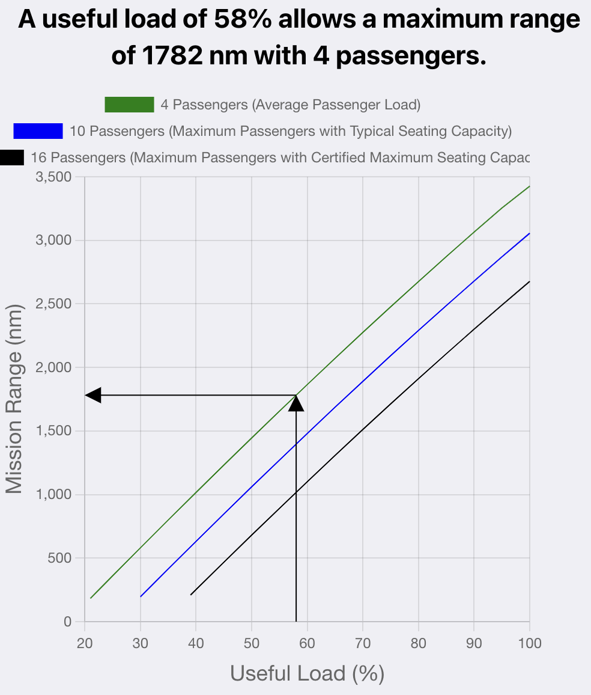
Evaluation Model: Mission Range vs. Useful Load Diagram
Go to Table of Contents
Three passenger loading conditions are displayed in SARLAT 2
The Bombardier CL605 can fly four passengers and two pilots 1782 nm (with NBAA fuel reserves) from the 5,500-foot runway in dry conditions.
SARLAT 2 displays the mission range using the average passenger load (four passengers).

Slide 28
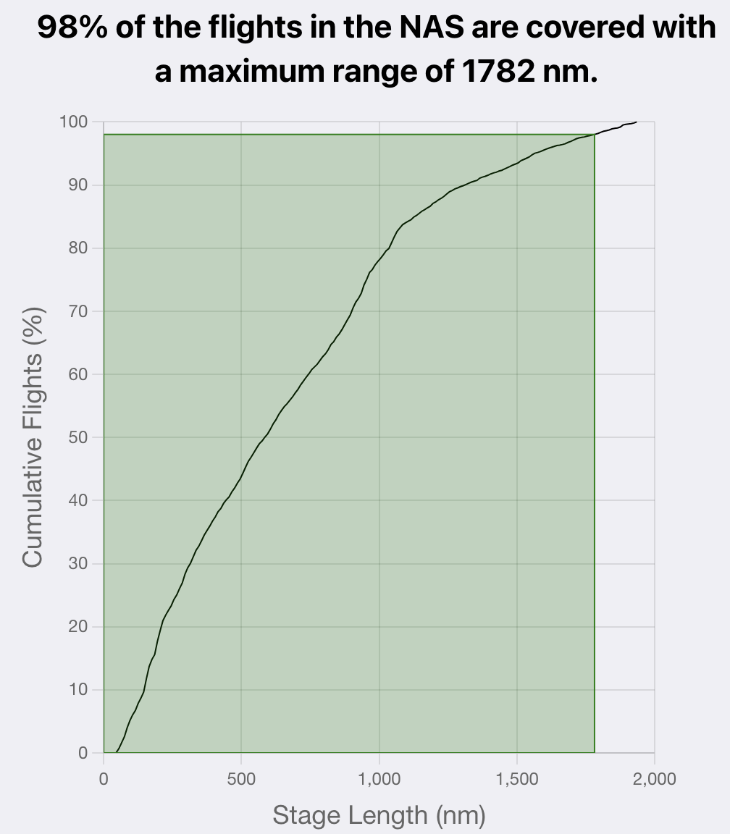
Evaluation Model: Cumulative Flights Coverage
Go to Table of Contents
SARLAT 2 displays the cumulative flights in the National Airspace System considering the mission stage length for the flight.
The Bombardier CL605 with a mission range of 1782 nm covers 98% of the historical flights performed in the National Airspace System.
The Bombardier CL605 can fly four passengers and two pilots 1782 nm (with NBAA fuel reserves) from the 5,500-foot runway in dry conditions.

Slide 29
Runway Evaluation Mode: Part 135 Operations
Go to Table of Contents
Evaluation
Conditions
Pressure altitude = 3,000 feet
Runway length = 5,500 feet
Design temperature = 85 deg. F.
Runway gradient = 0.0%
Surface = paved
Landing table shows if the aircraft can operate at maximum allowable landing weight perform Part 135 air taxi operations
Runway Evaluation Conditions
The Bombardier Challenger 605 can land in dry and wet runway conditions without landing correction factors applied.
The aircraft can land on a 5,500-foot runway dry runway if 14 CFR Part 135 standard criteria is used (landing distance is 60% of the runway length available).
The Challenger 605 cannot land in wet runway conditions under Part 135.

Slide 30
Runway Evaluation: Aircraft Data Table
Go to Table of Contents
Aircraft table with general information about each aircraft modeled in SARLAT 2.
Information includes engine type, aircraft design group, aircraft approach category, operating empty weight, useful load, maximum takeoff weight, maximum allowable landing weight, takeoff flap setting used in SARLAT 2, landing flap setting used in SARLAT 2, and the criteria for the takeoff distance estimate (e.g., accelerate-stop distance, takeoff distance, etc.)

Slide 31
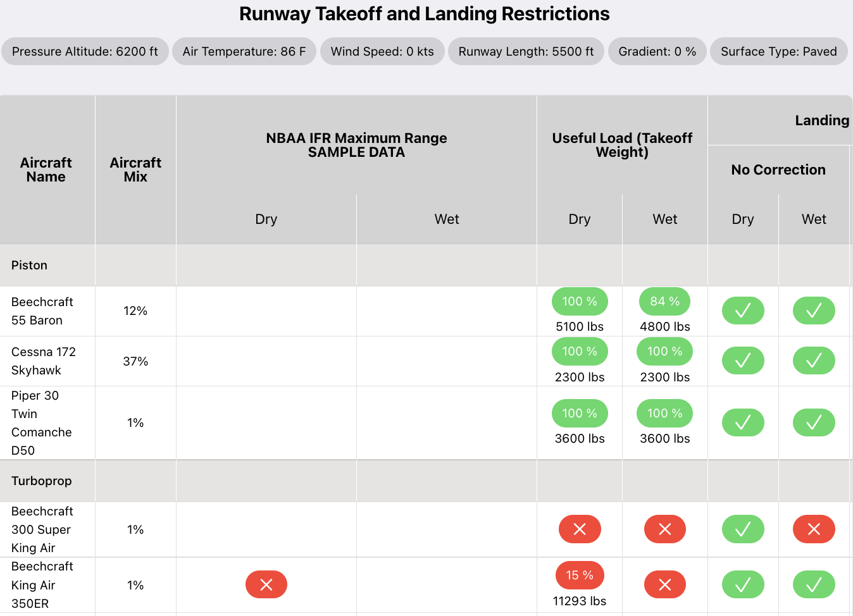
Infeasible Operating Conditions in the Runway Evaluation Mode
Go to Table of Contents
Example:
Demanding airport conditions
Some aircraft cannot operate from a 5,500 ft. runway at 6,200 for elevation and 86 deg. Fahrenheit temperature with a practical useful load
Pressure altitude = 6,200 feet
Runway length = 5,500 feet
Design temperature = 86 deg. F.
Runway gradient = 0%
Surface = dry
Design Conditions
Aircraft with red cross mark cannot operate at the airport conditions selected

Slide 32
Runway Design Mode
Objective: Estimate the unconstrained runway length required by a known aircraft fleet mix
Go to Table of Contents

Slide 33
Runway Design Mode
Go to Table of Contents
Objective:
To estimate the unconstrained runway length required by a proposed aircraft fleet mix
Output Produced
Takeoff runway distance requirements (dry and wet)
Landing runway distance requirements (dry, wet, Part 135 dry and Part 135 wet)

Slide 34
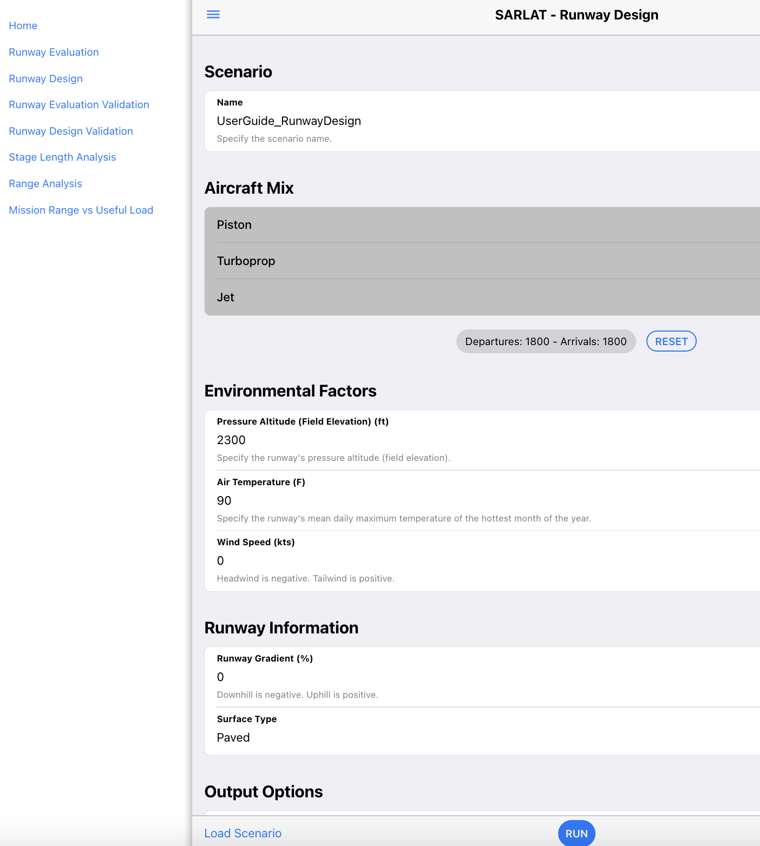
Runway Design Mode Interface
Go to Table of Contents
Step 2: Name your scenario
Step 1: Select Runway Design mode
Step 3: Select the aircraft to be considered in the runway design
Step 4: Enter the airport
environmental conditions
Step 5: Enter the runway grade and surface
Step 6: Select the output options
Step 7: Run the case

Slide 35
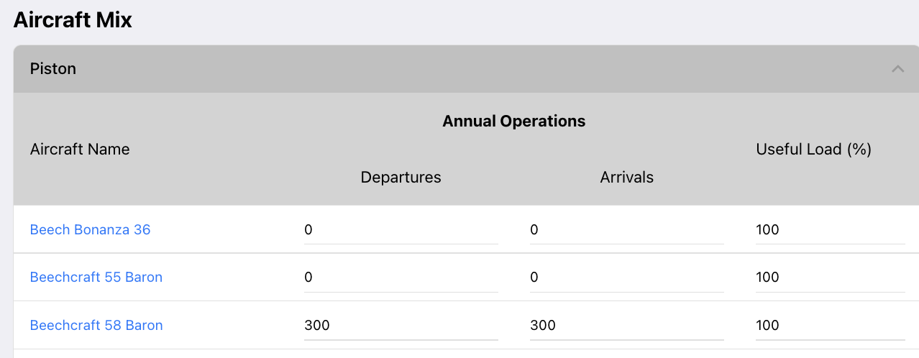
Runway Design Mode: Fleet Mix Parameters (Piston Aircraft)
Go to Table of Contents
Step 1: Define the annual operations for each aircraft. Arrivals and departures are defined separately.
Step 2: Define the target useful load carried for departure operations
SARLAT 2 reports landing runway performance at the maximum landing weight.
The useful load definition above only affects departure operations.

Slide 36
Runway Design Mode: Fleet Mix Parameters for Large Turboprop Aircraft (Those with Maximum Takeoff Weight 12,500 lbs. or Higher)
Go to Table of Contents
Step 1: Define the annual operations for each aircraft. Arrivals and departures are defined separately.
Step 3: Define if SARLAT 2 is expected to report Part 135 landing requirements.
Step 2: Define the critical range for each aircraft for runway design calculations. The critical range is determined using TFMC data.
SARLAT 2 automatically calculates the useful load equivalent to fly the critical range selected in the third column.

Slide 37
Runway Design Mode: Fleet Mix Parameters for Jet-Powered Aircraft
Go to Table of Contents
Step 1: Define the annual operations for each aircraft. Arrivals and departures are defined separately.
Step 3: Define if SARLAT 2 is expected to report Part 135 landing requirements.
Step 2: Define the critical range for each aircraft for runway design calculations. The critical range is determined using TFMC data.
SARLAT 2 automatically calculates the useful load equivalent to fly the critical range selected in the third column.

Slide 38
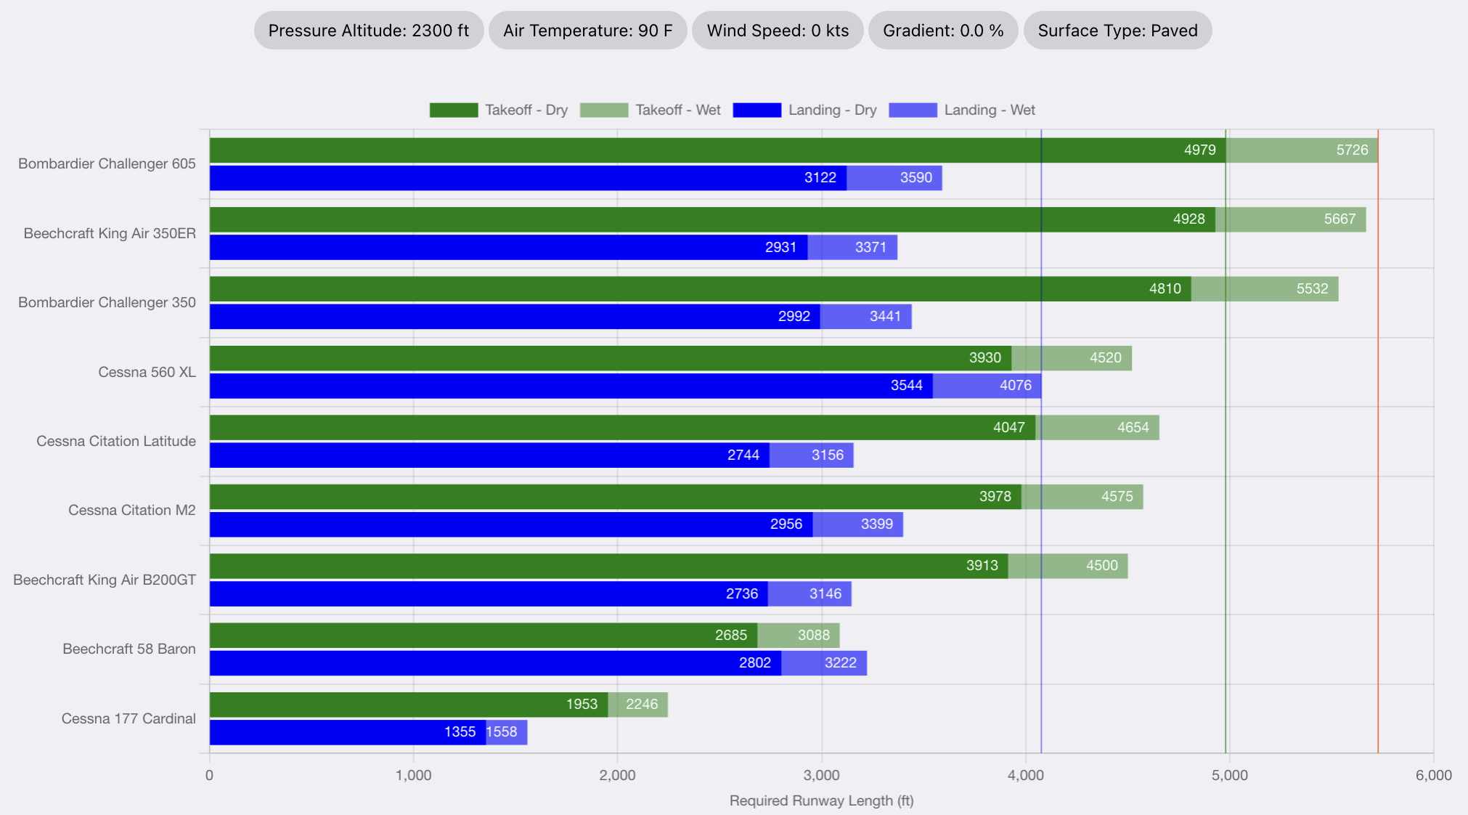
Runway Design Graphical Output
Go to Table of Contents
Design
Conditions
Pressure altitude = 2,300 feet
Design temperature = 90 deg. F.
Useful loads determined by the critical length flown by each aircraft
Wind speed = 0 knots
Runway gradient = 0%
Provides a graphical output of runway length requirements for each aircraft
The Bombardier Challenger 605 is the critical aircraft in this example.
Runway Design Conditions
The Bombardier Challenger 605 requires 4,970 feet of runway for takeoff (dry pavement)
Round to 5,000 feet.
5,726 feet of runway needed with wet pavement
Rounded to 5,700 feet.

Slide 39
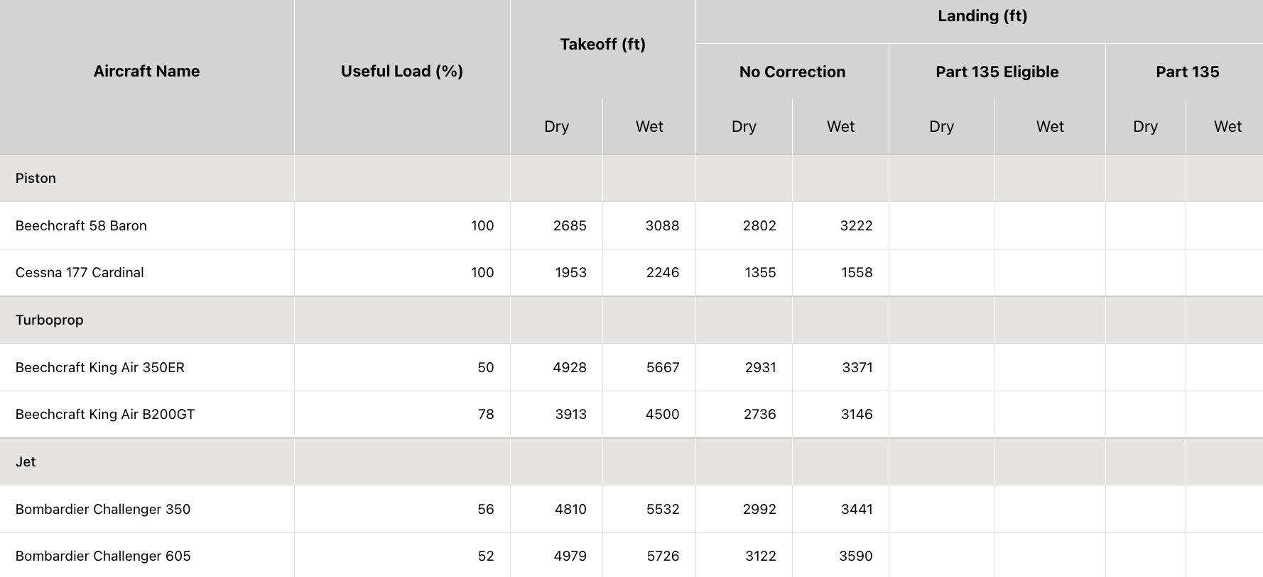
Runway Design Table Output
Go to Table of Contents
Provides a table output of runway length requirements for each aircraft
Two takeoff conditions provided (wet/dry)
Multiple landing conditions provided (wet, dry and Part 135)
Design
Conditions
Pressure altitude = 2,300 feet
Design temperature = 90 deg. F.
Wind speed = 0 knots
Runway gradient = 0%
Landing distance output
Takeoff distance output

Slide 40
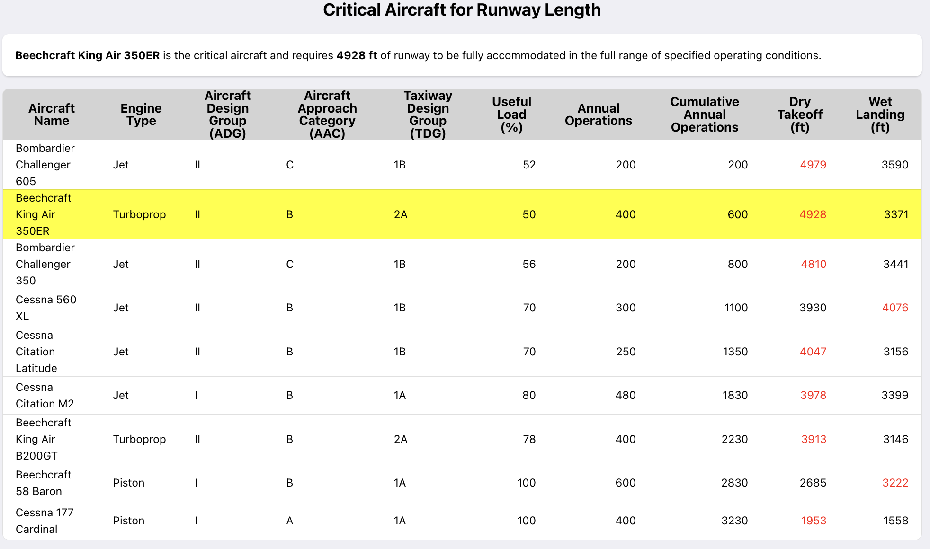
Critical Aircraft Considering Runway Design Parameters
Go to Table of Contents
Provides a table output of runway length requirements for each aircraft
Shows the cumulative annual operations for all aircraft sorted from the highest to the smallest runway length
Design
Conditions
Pressure altitude = 2,300 feet
Design temperature = 90 deg. F.
Wind speed = 0 knots
Runway gradient = 0%
The Beechcraft King Air B350ER is the critical aircraft and requires 4,928 feet of runway for takeoff (dry pavement)
Round to 4,900 feet.
The critical aircraft for runway length requirement is the first aircraft with 500 or more annual operations (highlighted in yellow).

Slide 41
Critical Aircraft According to Other Design Parameters
Go to Table of Contents
Provides a table output of the critical aircraft according to: ADG, AAC, TDG and RDC
SARLAT 2 selects the most critical aircraft for each of the four parameters individually.
Design
Conditions
Pressure altitude = 2,300 feet
Design temperature = 90 deg. F.
Wind speed = 0 knots
Runway gradient = 0%
For the example shown:
The critical aircraft according to ADG group is II (the Challenger 605)
The critical aircraft according to AAC group is C (the Challenger 605)
Runway Design Code (RDC) is C-II
The critical aircraft for Taxiway Design Group (TDG) is 2A (the King Air B350ER)

Slide 42
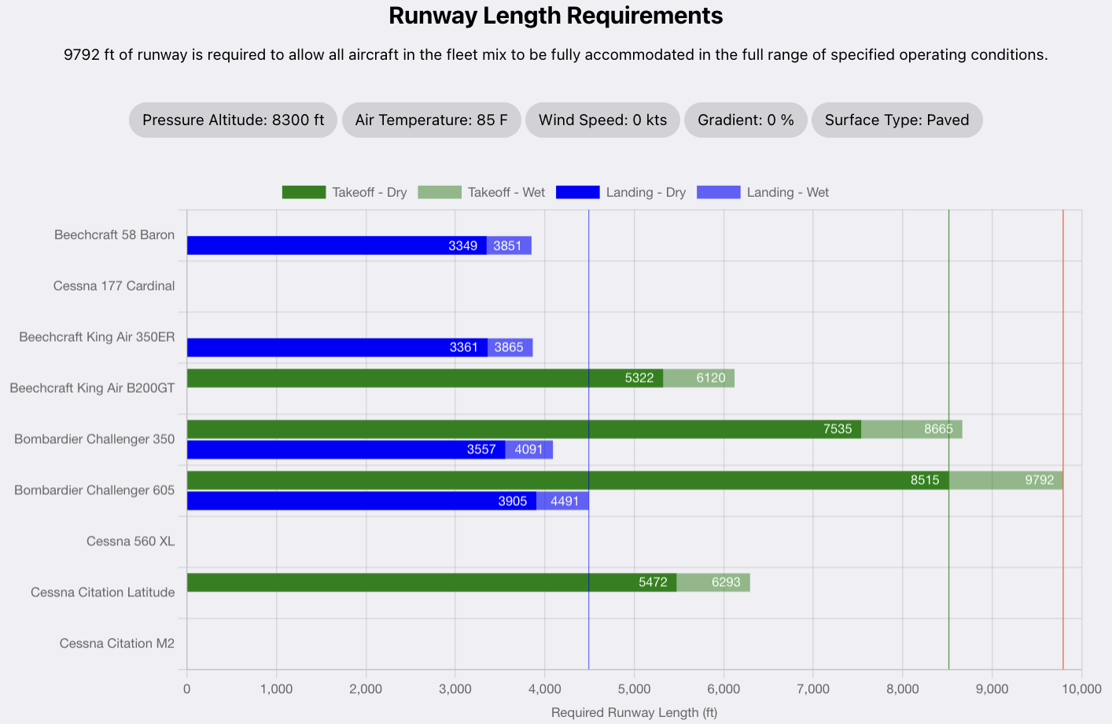
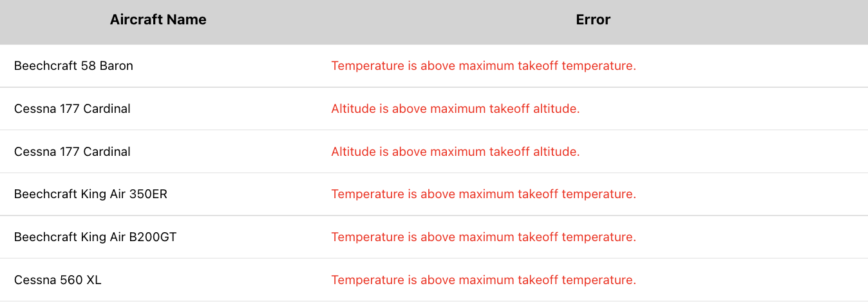
Infeasible Operating Conditions in the Runway Design Mode
Go to Table of Contents
Example:
Demanding airport design conditions
8300 feet pressure altitude
85 deg. F. design temperature
Aircraft not reported in bar plot cannot operate at the airport design conditions

Slide 43
Runway Evaluation Validation Mode
Objective: Provides a graphical depiction of aircraft takeoff weight and runway length required for various design parameters (temperature, runway grade, and wind speed)
Go to Table of Contents

Slide 44
Runway Evaluation Validation Mode
Go to Table of Contents
Objective:
Provides a graphical depiction of aircraft takeoff weight and runway length required for various design parameters (temperature, runway grade, and wind speed)
Output Produced
Plot of runway length versus takeoff weight

Slide 45
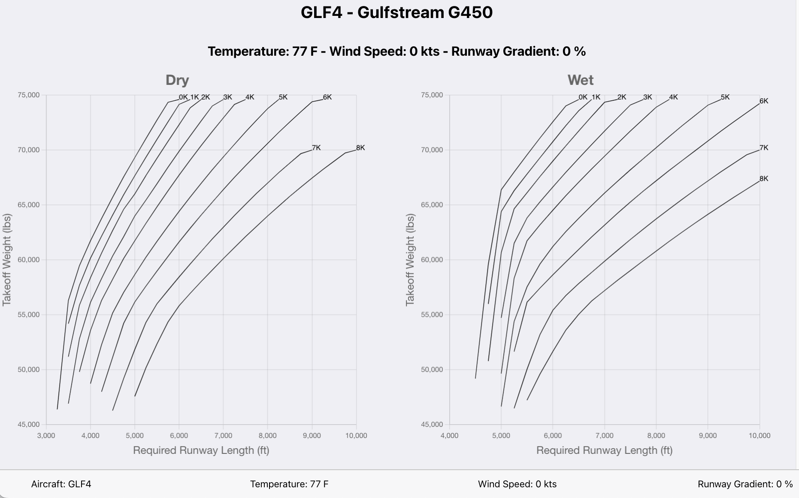
Runway Evaluation Validation Mode
Go to Table of Contents
Plot shows the aircraft takeoff weight and runway length required for selected airport environmental conditions
Step 1: Select the aircraft and airport conditions (Temperature, Wind Speed and Gradient) to be considered in the runway evaluation.
SARLAT 2 reports dry and wet pavement conditions are reported

Slide 46
Runway Design Validation Mode
Objective: Provides a graphical depiction of aircraft takeoff weight and runway length required for various design parameters (temperature, runway grade, and useful load
Go to Table of Contents

Slide 47
Runway Design Validation Mode
Go to Table of Contents
Objective:
Provides a graphical depiction of aircraft takeoff weight and runway length required for various design parameters (temperature, runway grade, and useful load
Output Produced
Plot of runway length versus takeoff weight at different airport elevations and airport environmental conditions

Slide 48
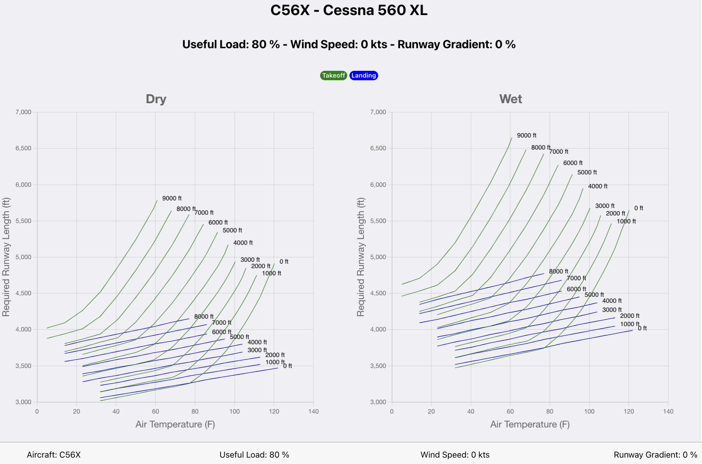
Runway Design Validation Mode
Go to Table of Contents
Plot shows the uncorrected runway length (for takeoff and landing) as a function of pressure altitude and airfield temperature
Dry and Wet pavement
conditions are reported
Step 1: Select the aircraft and airport conditions (useful load, wind speed and gradient) to be considered in the runway design.

Slide 49
Aircraft Stage Length Analysis
Objective: Provides a graphical information of the cumulative number flights versus distance flown in the National Airspace System
Go to Table of Contents

Slide 50
Stage Length Analysis
Go to Table of Contents
Objective:
Provides a graphical information of the cumulative number flights versus distance flown in the National Airspace System
Output Produced
Plot of cumulative number of flights versus distance flown (stage length).
The plot is individual by aircraft.
All aircraft in SARLAT 2 have a cumulative plot.

Slide 51
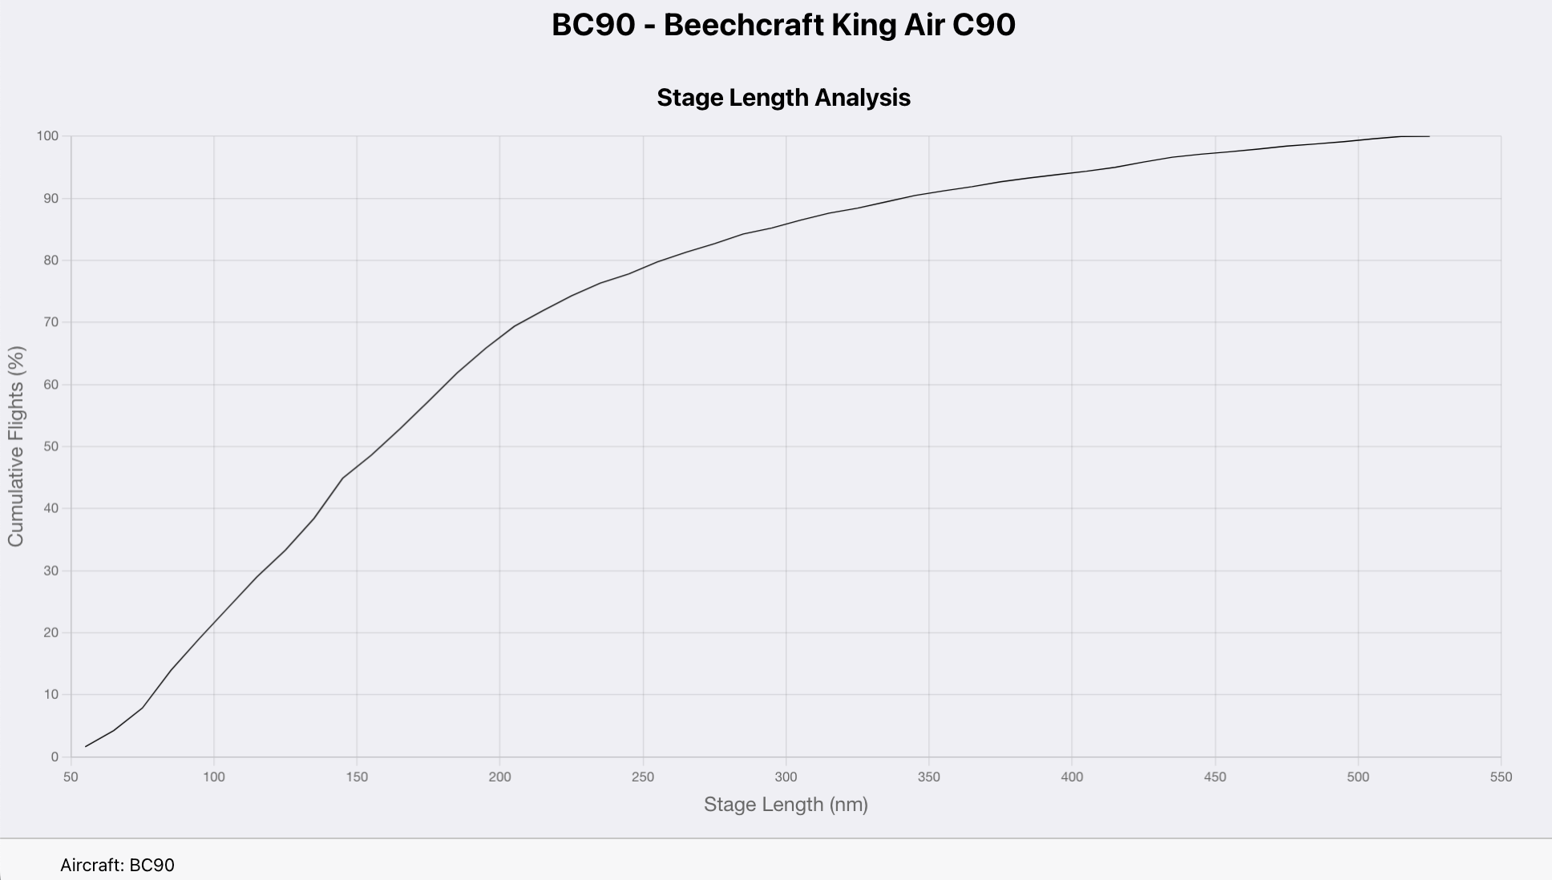
Stage Length Analysis
Go to Table of Contents
50% of the King Air C90 flights are 160 nm or less.
Step 1: Select the aircraft to be plotted

Slide 52
Aircraft Range Analysis
Objective: Provides a graphical information of useful load and mission distance flown for jet-powered aircraft and turboprops whose maximum takeoff gross weight is 12,500 lbs. or more.
Go to Table of Contents

Slide 53
Aircraft Range Analysis
Go to Table of Contents
Objective:
Provides a graphical information of useful load and mission distance flown for jet-powered aircraft and turboprops whose maximum takeoff gross weight is 12,500 lbs. or more.
Output Produced
Payload-range diagram with useful load and mission range.
The plot is individual by aircraft.

Slide 54
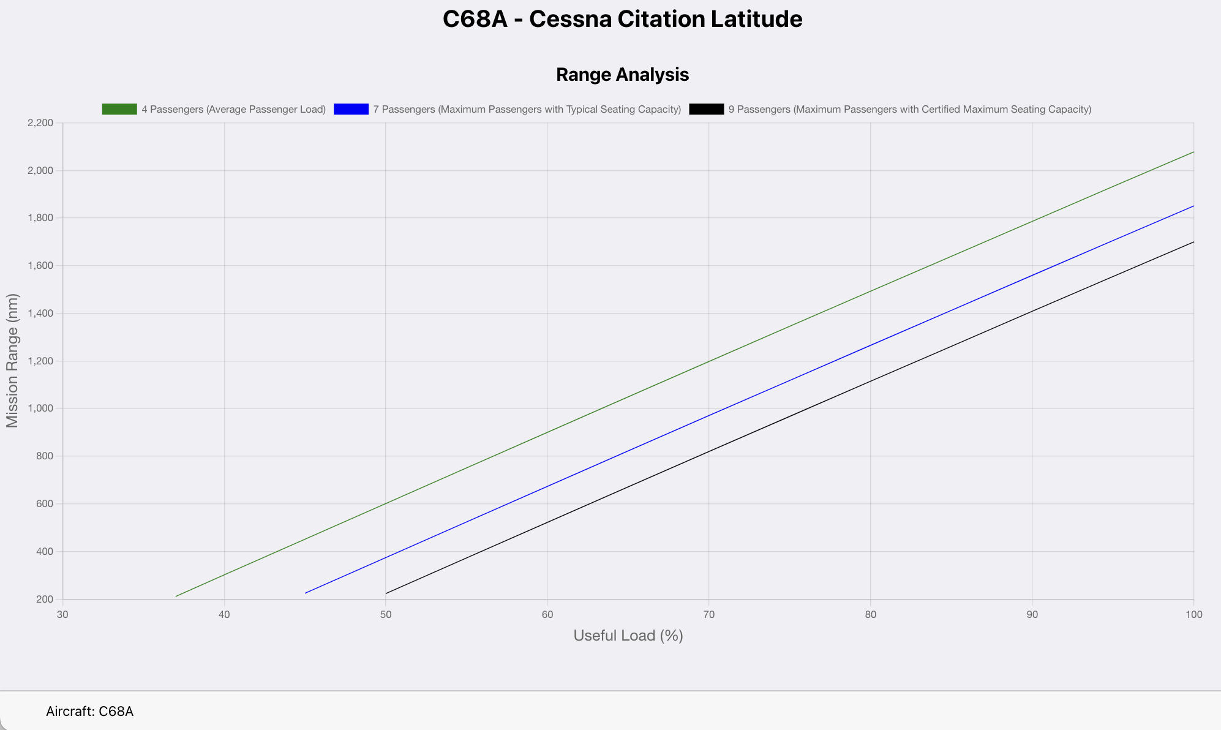
Aircraft Range Analysis
Go to Table of Contents
With a useful load of 71% the Cessna Citation Latitude (C68A) can fly four passengers and two pilots 1,200 nm with National Business Aircraft Association (NBAA) fuel reserves.
Step 1: Select the aircraft of interest

Slide 55
Saving and Exporting Data in SARLAT 2
Go to Table of Contents

Slide 56
Exporting and Saving Scenario Runs
Go to Table of Contents
SARLAT can export data for use in spreadsheets or the clipboard
SARLAT can load saved scenarios
SARLAT can save the graphical output produced in Portable Graphics Format (PNG)
SARLAT exports table results in two formats:
Clipboard
Excel

Slide 57
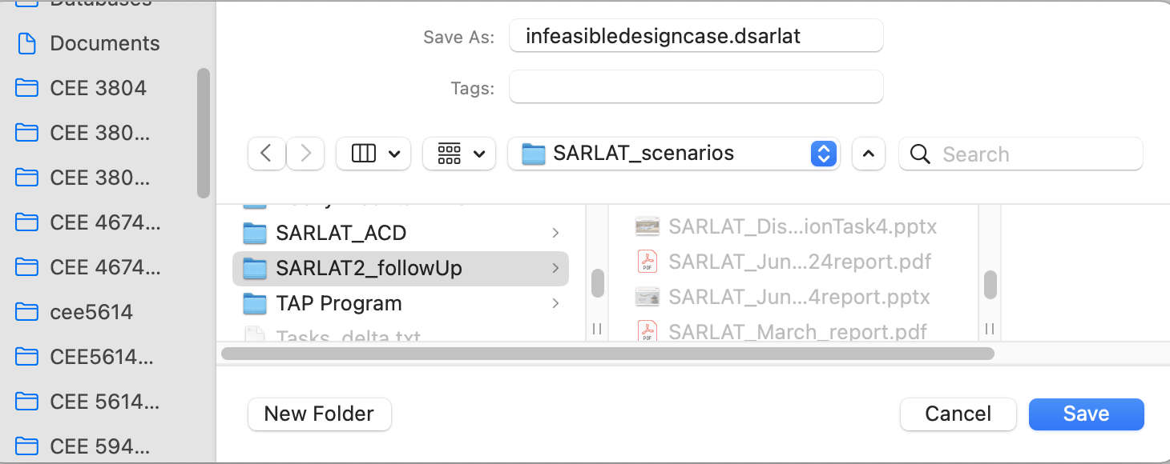
Saving SARLAT Scenario Runs
Go to Table of Contents
SARLAT saves your run using the .dsarlat type file
Step 1: Click the save button
Step 2: Name and navigate to the destination folder to save the scenario

Slide 58
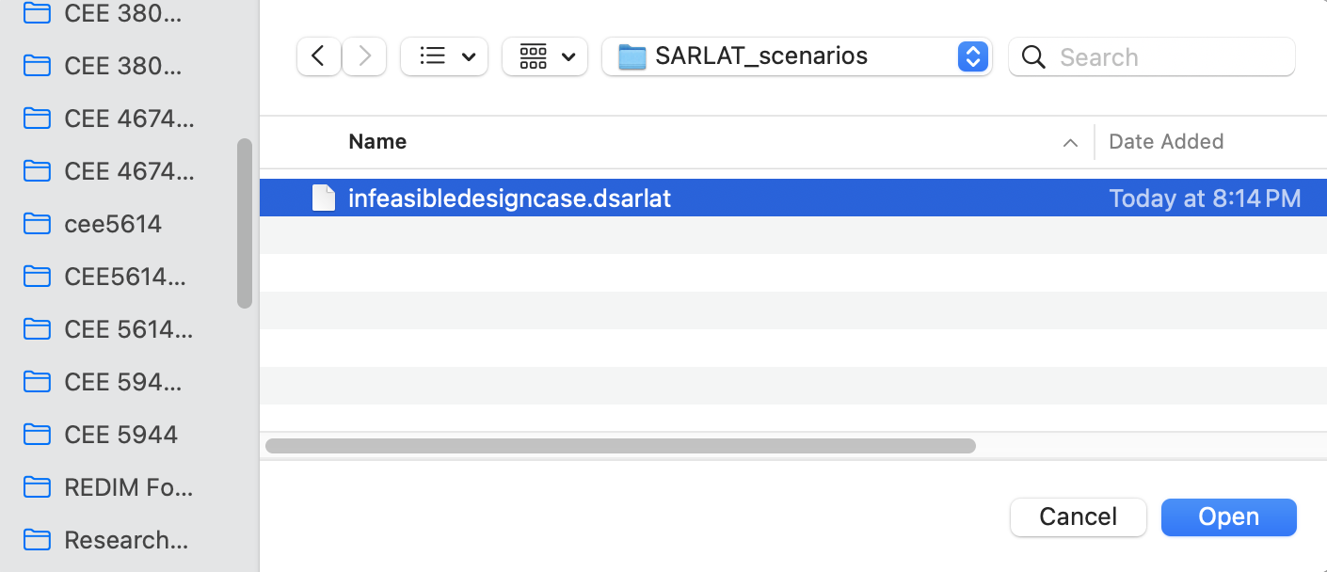
Loading SARLAT Scenario Runs
Go to Table of Contents
SARLAT 2 loads saved .dsarlat files with saved scenario runs
Step 1: Click “Load Scenario”
Step 2: Navigate to the folder to load the scenario

Slide 59
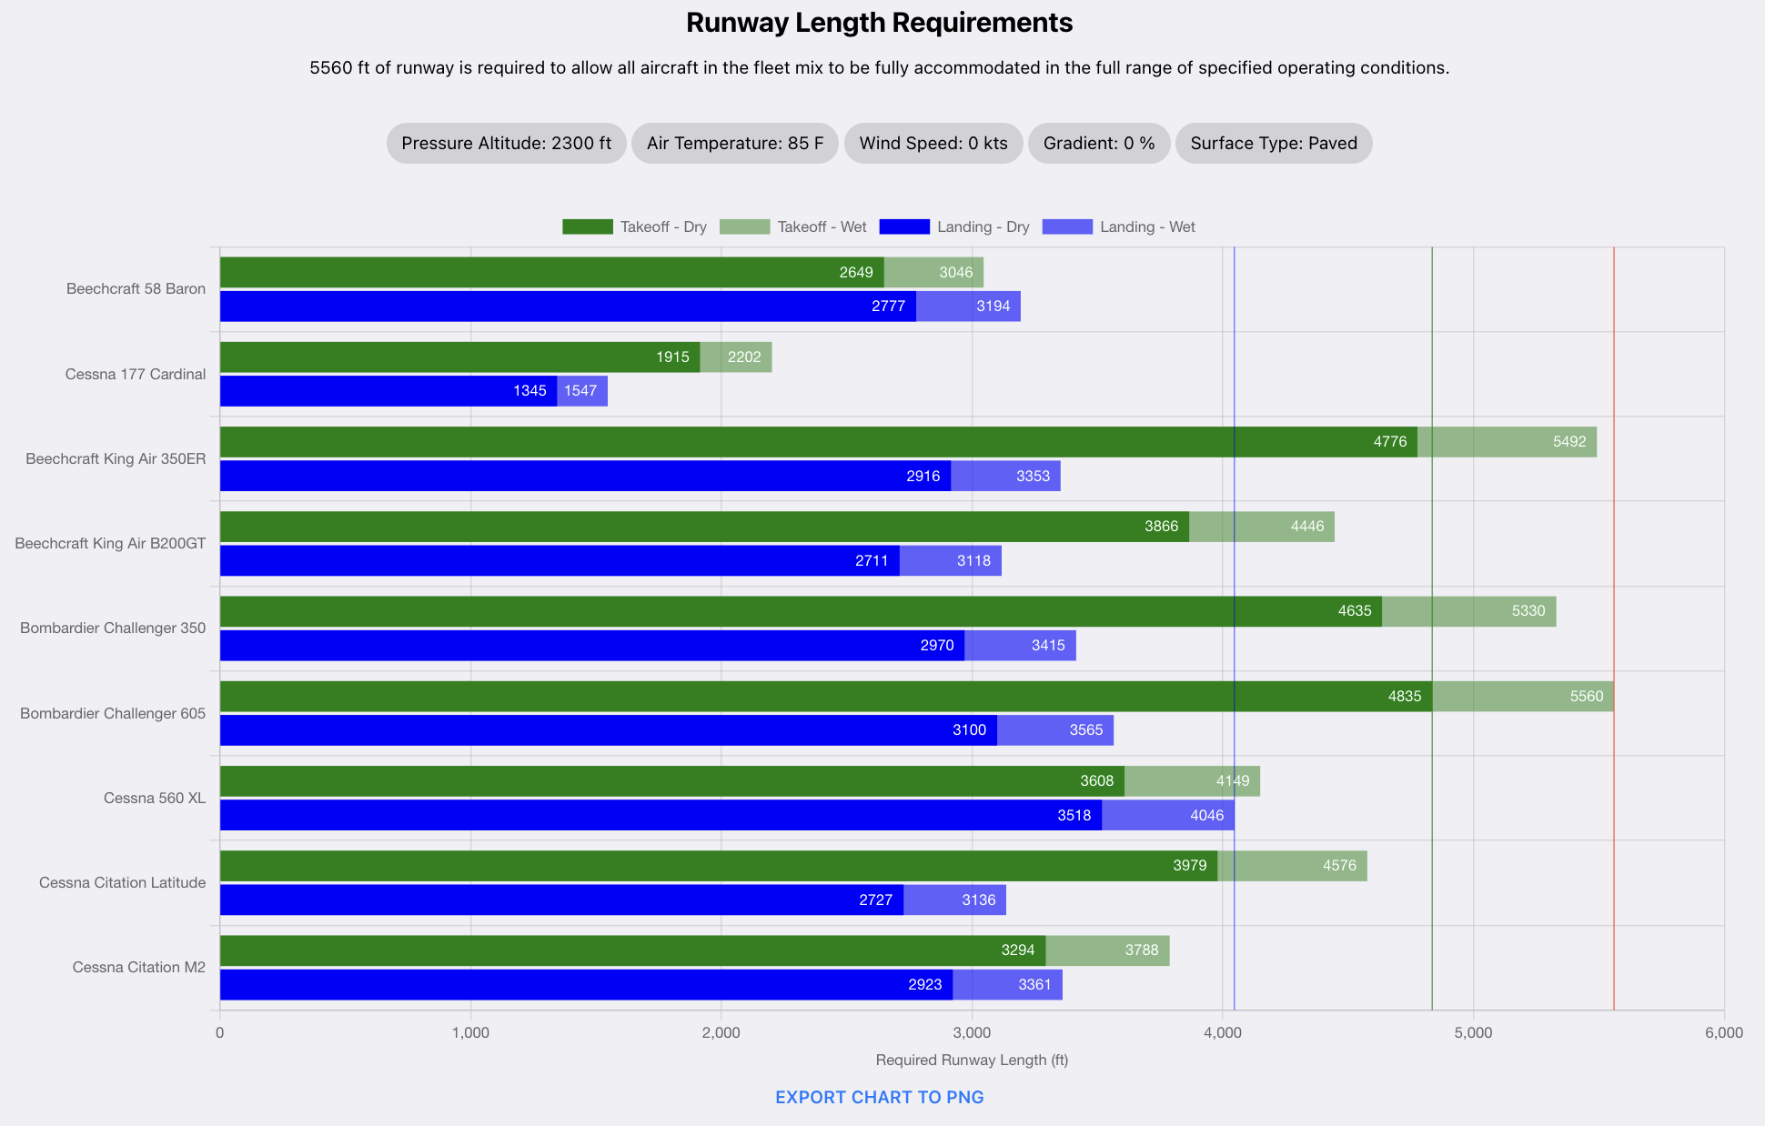
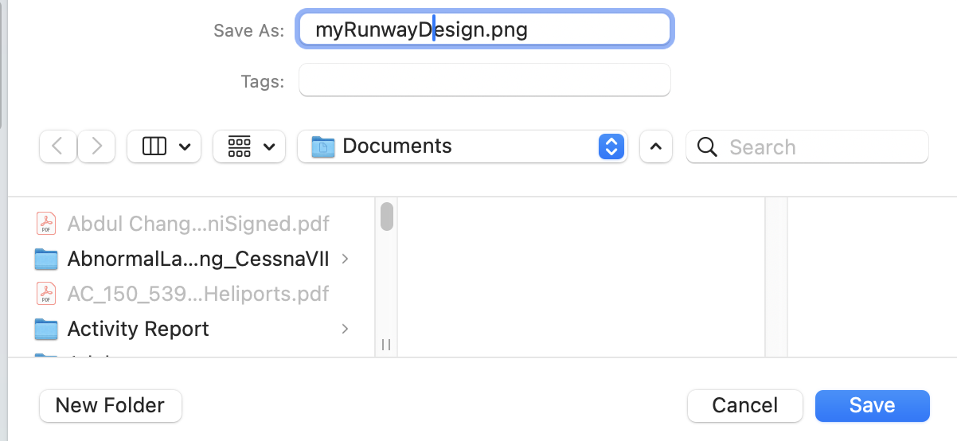
Exporting SARLAT 2 Graphical Output
Go to Table of Contents
SARLAT 2 saves graphic output as Portable Network Graphic (PNG) files
Step 2: Navigate to the destination folder and indicate a file name.
Step 1: Click “Export Chart to PNG”

Slide 60
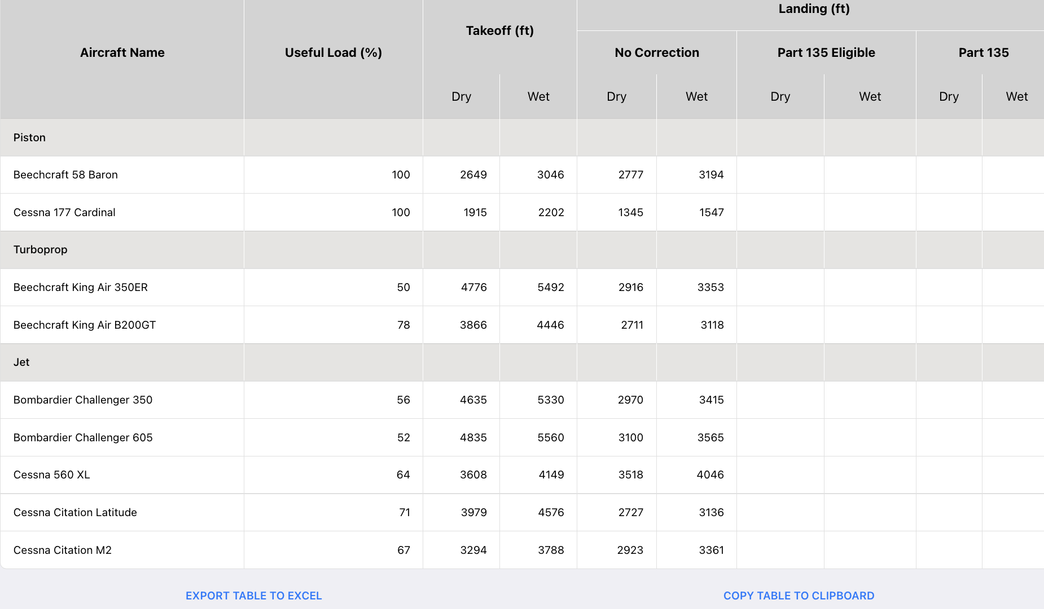
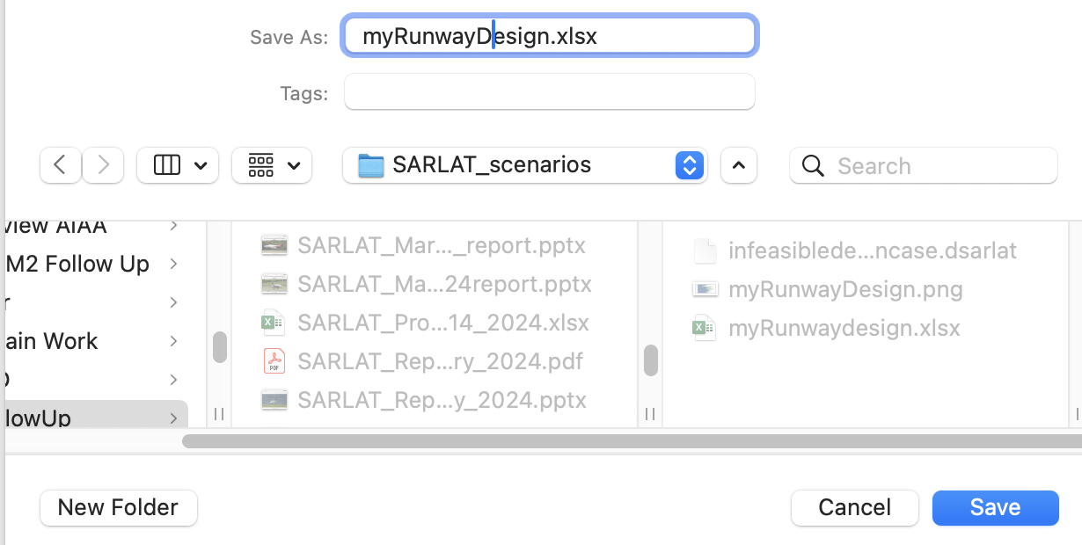
Exporting SARLAT 2 Numerical Output Data
Go to Table of Contents
SARLAT 2 saves numerical output data in Excel format or to the Clipboard
Step 2: Navigate to the destination folder and indicate a file name.
Step 1: Click “Export Table to Excel”

Slide 61
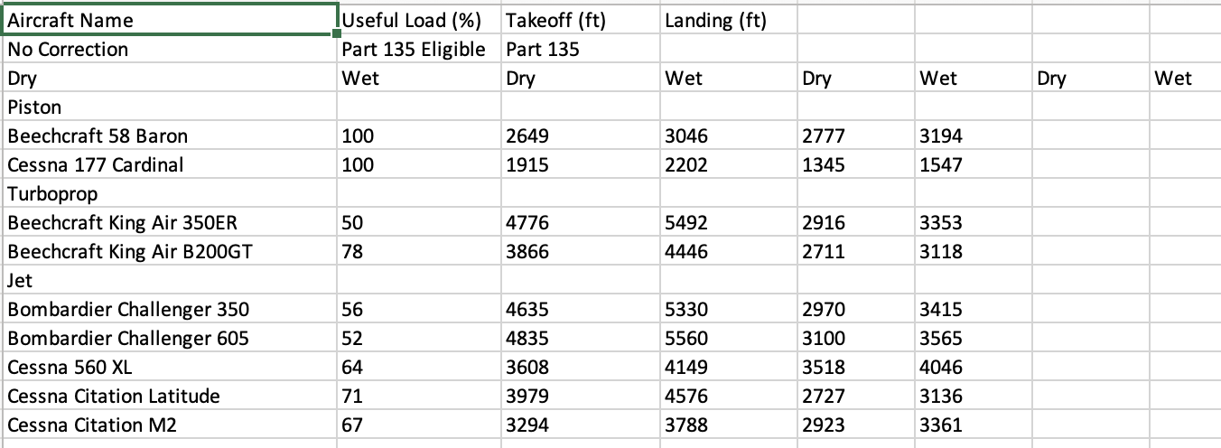
Exporting SARLAT 2 Excel Output File
Go to Table of Contents
SARLAT 2 Excel output format
Uncorrected landing data (feet)
Part 135 landing data (feet) if applicable
Useful load values (%)
Takeoff data (feet)

Slide 62
Go to Table of Contents
Critical Aircraft Based on Runway Length
Objective: Determine the critical aircraft considering runway length analysis criteria.

Slide 63
Critical Aircraft Based on Runway Length
Go to Table of Contents
The critical aircraft considering runway length requirements is reported as the aircraft in a sorted list of runway length requirements with 500 or more cumulative annual operations
The cumulative annual operations is the sum of departures and landings defined in the Runway Design Case input screen
The Beechcraft King Air B350ER is the critical aircraft and requires 4,928 feet of runway for takeoff (dry pavement). Runway length is rounded to 4,900 feet.

Slide 64
Critical Aircraft Based on Runway Length (2)
Go to Table of Contents
The table below shows a sorted list of aircraft considering runway length requirements for dry takeoff and wet landing conditions
The sorted list is arranged in descending order using the dry takeoff distance as the reference condition.
The Beechcraft King Air B350ER is the critical aircraft and requires 4,928 feet of runway for takeoff (dry pavement). Runway length is rounded to 4,900 feet.

Slide 65
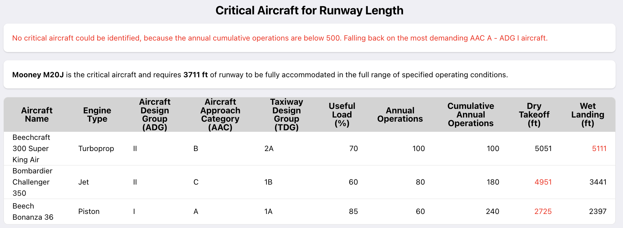
No Critical Aircraft Based on Runway Length Example
Go to Table of Contents
If the cumulative number of annual operations at the airport do not reach 500, no critical aircraft is reported using the sorted method explained in the previous slides
SARLAT 2 reports the critical aircraft as the most demanding aircraft in categories ADG I and AAC A for the design conditions
For the example below, the Mooney M20J is found to be the most demanding ADG I and AAC A

Slide 66
Case Study # 1: Runway Design
Go to Table of Contents

Slide 67
New Airport Description
Go to Table of Contents
A small rural, community plans to build a new airport
The new airport will be equipped with a single, paved runway
The anticipated aircraft fleet mix was developed for the new airport
The critical aircraft for the 20-year planning period was identified as the Beechcraft King Air B200GT.
The critical aircraft is defined by the Federal Aviation Administration (FAA) in Advisory Circular 150/5000-17, Critical Aircraft and Regular Use Determination (2017) as the most demanding aircraft to make regular use of the airport (at least 500 annual operations, including itinerant and local operations).
No aircraft operating under Part 135 regulations are anticipated at this airport for the planning period (i.e., Part 135 operations are not selected in the analysis)
The proposed airport will be built at an elevation of 1,930 feet Mean Sea Level (MSL)
The design temperature, the mean daily maximum temperature of the hottest month of the year, is projected to be 88 degrees Fahrenheit (in July)
Wind conditions were assumed to be calm for the analysis
Preliminary engineering analysis for the proposed runway has determined an anticipated runway gradient of 0.8%.

Slide 68
New Airport Projected Fleet Mix and Design Conditions
Go to Table of Contents
Aircraft Name | Useful Load (%) | Annual Departures | Annual Arrivals
Piston
Beechcraft 58 Baron | 100 | 215 | 215
Cessna 172 Skyhawk | 100 | 745 | 745
Cessna 182 Skylane | 100 | 370 | 370
Cirrus SR 22 | 100 | 260 | 260
Mooney M20J | 100 | 200 | 200
Vans RV 12 | 100 | 120 | 120
Turboprop
Beechcraft B200 King Air | 90 | 260 | 260
Pilatus PC 12 NG | 90 | 90 | 90
Socata TBM 700 | 90 | 70 | 70
Parameter | Value
Pressure Altitude (Field Elevation) (ft) | 1930
Air Temperature (F) | 88
Wind Speed (knots) | 0
Runway Gradient (%) | 0.8
Surface Type | Paved

Slide 69
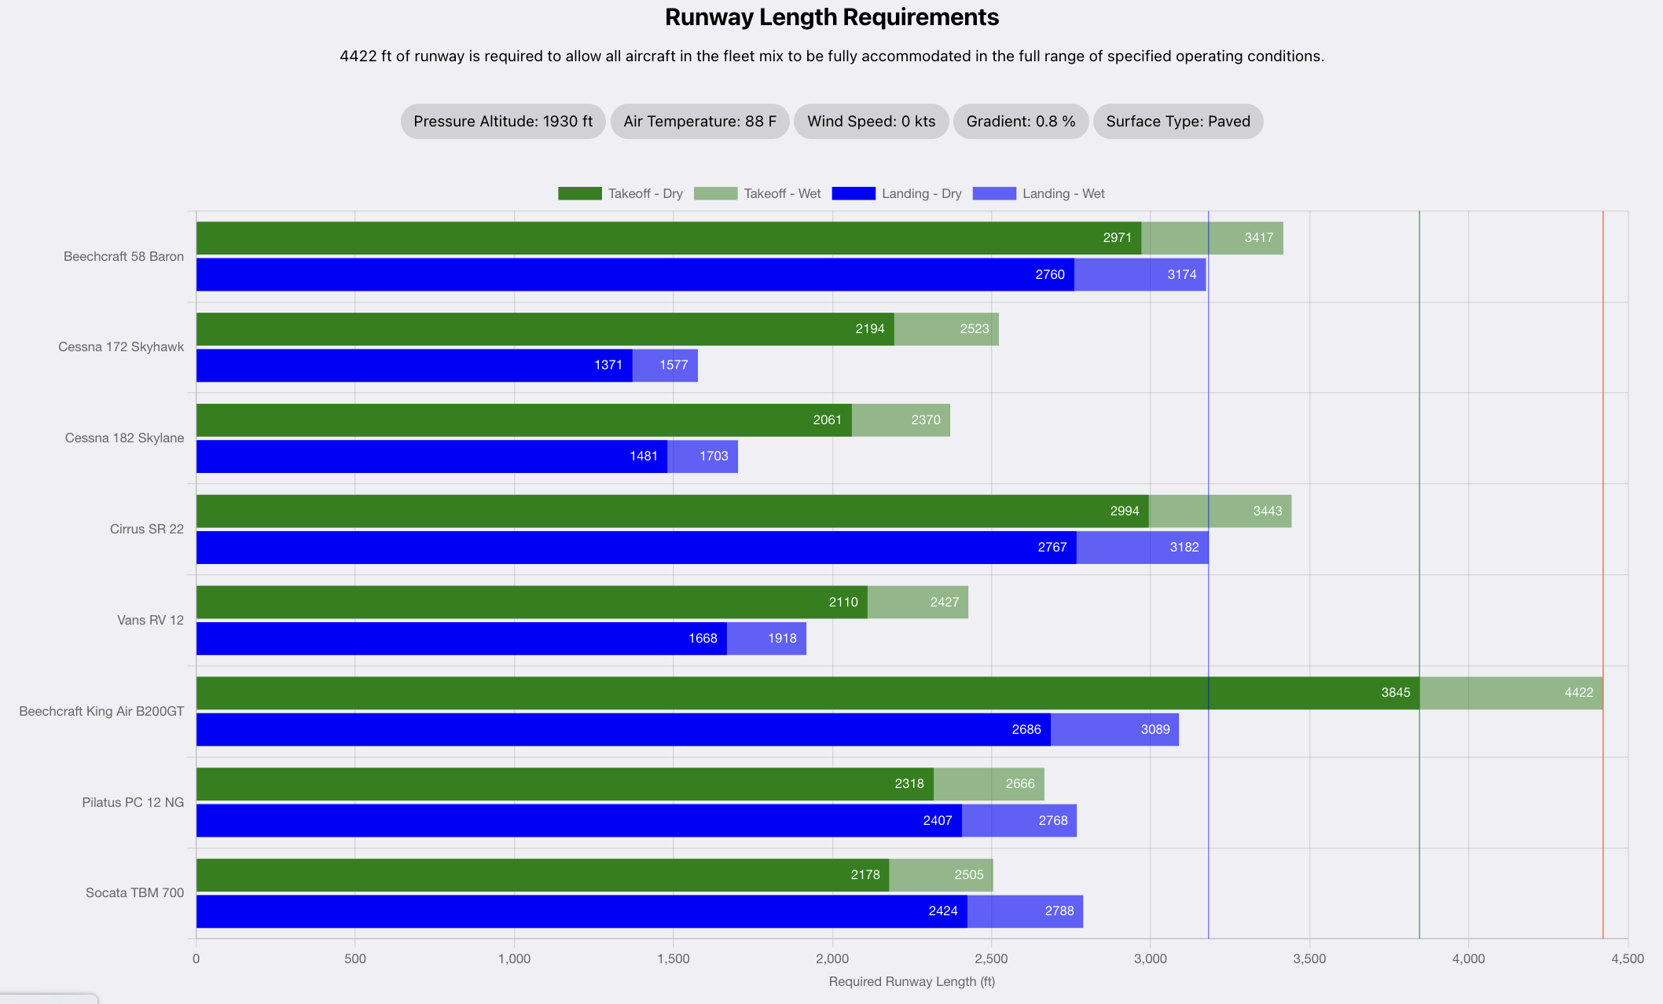
New Airport Runway Length Requirements: Graphical Output
Go to Table of Contents
The Beechcraft King Air B200GT has the longest runway length requirement

Slide 70
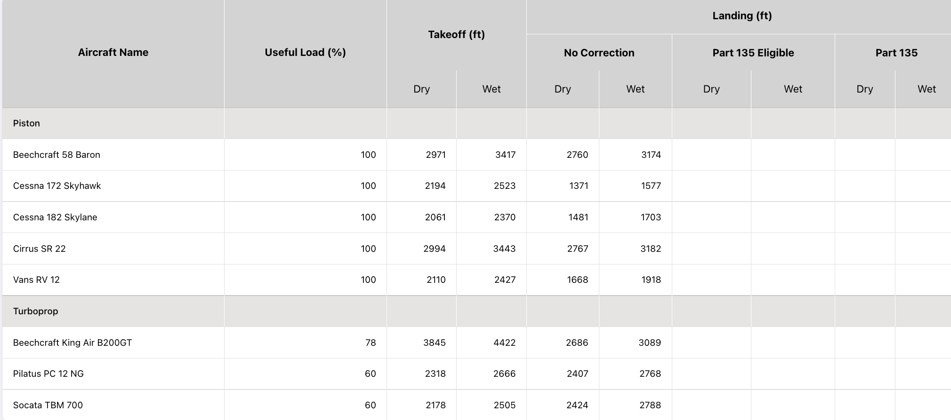
New Airport Runway Length Requirements
Table Output
Go to Table of Contents
The Beechcraft King Air B200GT has the longest runway length requirement

Slide 71
New Airport Analysis Summary
Go to Table of Contents
The analysis shows that a 3,900-foot long runway satisfies the dry pavement requirement for the Beechcraft King Air B200GT (the critical aircraft)
Wet landing conditions for the critical aircraft require a 3,100 foot runway (rounded from 3,089 feet)
AIP funds consider dry takeoff and wet pavement landing conditions

Slide 72
New Airport Sensitivity Analysis: Climate Change
Go to Table of Contents
The design explores future climate changes
Climate forecasts expect a ten-degree increase in the mean maximum temperature of the hottest month of the year by mid-century
SARLAT 2 output with design temperature of 98 degrees. F.
Beechcraft King Air B200GT requires 3,932 feet of runway (dry takeoff) with the new design conditions
The runway required is rounded to 4,000 feet for constructibility purposes.

Slide 73
Case Study # 2: Runway Evaluation
Go to Table of Contents

Slide 74
Existing Runway Airport Evaluation
Go to Table of Contents
Existing reliever airport with a 5,200-foot paved runway
The anticipated aircraft fleet mix was developed using FAA Traffic Management Systems counts
Part 135 regulations are anticipated at this airport for the planning period (i.e., Part 135 operations are selected in the analysis)
The airport is located at an elevation of 2,960 feet Mean Sea Level (MSL)
The design temperature, the mean daily maximum temperature of the hottest month of the year, is 85 degrees Fahrenheit (in August)
Wind conditions were assumed to be calm for the analysis
The existing runway has a gradient of 0.6%.

Slide 75
Existing Airport Fleet Mix and Design Conditions
Go to Table of Contents
Aircraft Name | Annual Departures | Annual Arrivals
Piston
Beechcraft 58 Baron | 185 | 185
Cessna 152 | 1200 | 1200
Cessna 172 Skyhawk | 935 | 935
Mooney M20V Acclaim | 265 | 265
Turboprop
Beechcraft King Air 350ER | 270 | 270
Pilatus PC 12 NG | 345 | 345
Socata TBM 700 | 260 | 260
Jet
Bombardier Challenger 350 | 255 | 255
Cessna Citation 560XL | 145 | 145
Cessna Citation Latitude | 165 | 165
Cessna Citation X | 95 | 95
Cessna Citation CJ4 | 130 | 130
Cirrus Vision SF50 | 60 | 60
Embraer Phenom 300 | 270 | 270

Slide 76
Existing Airport Design Conditions
Go to Table of Contents
Parameter | Value
Existing Runway length (ft) | 5,200
Pressure Altitude (Field Elevation) (ft) | 2,960
Air Temperature (F) | 85
Wind Speed (knots) | 0
Runway Gradient (%) | 0.6
Surface Type | Paved

Slide 77
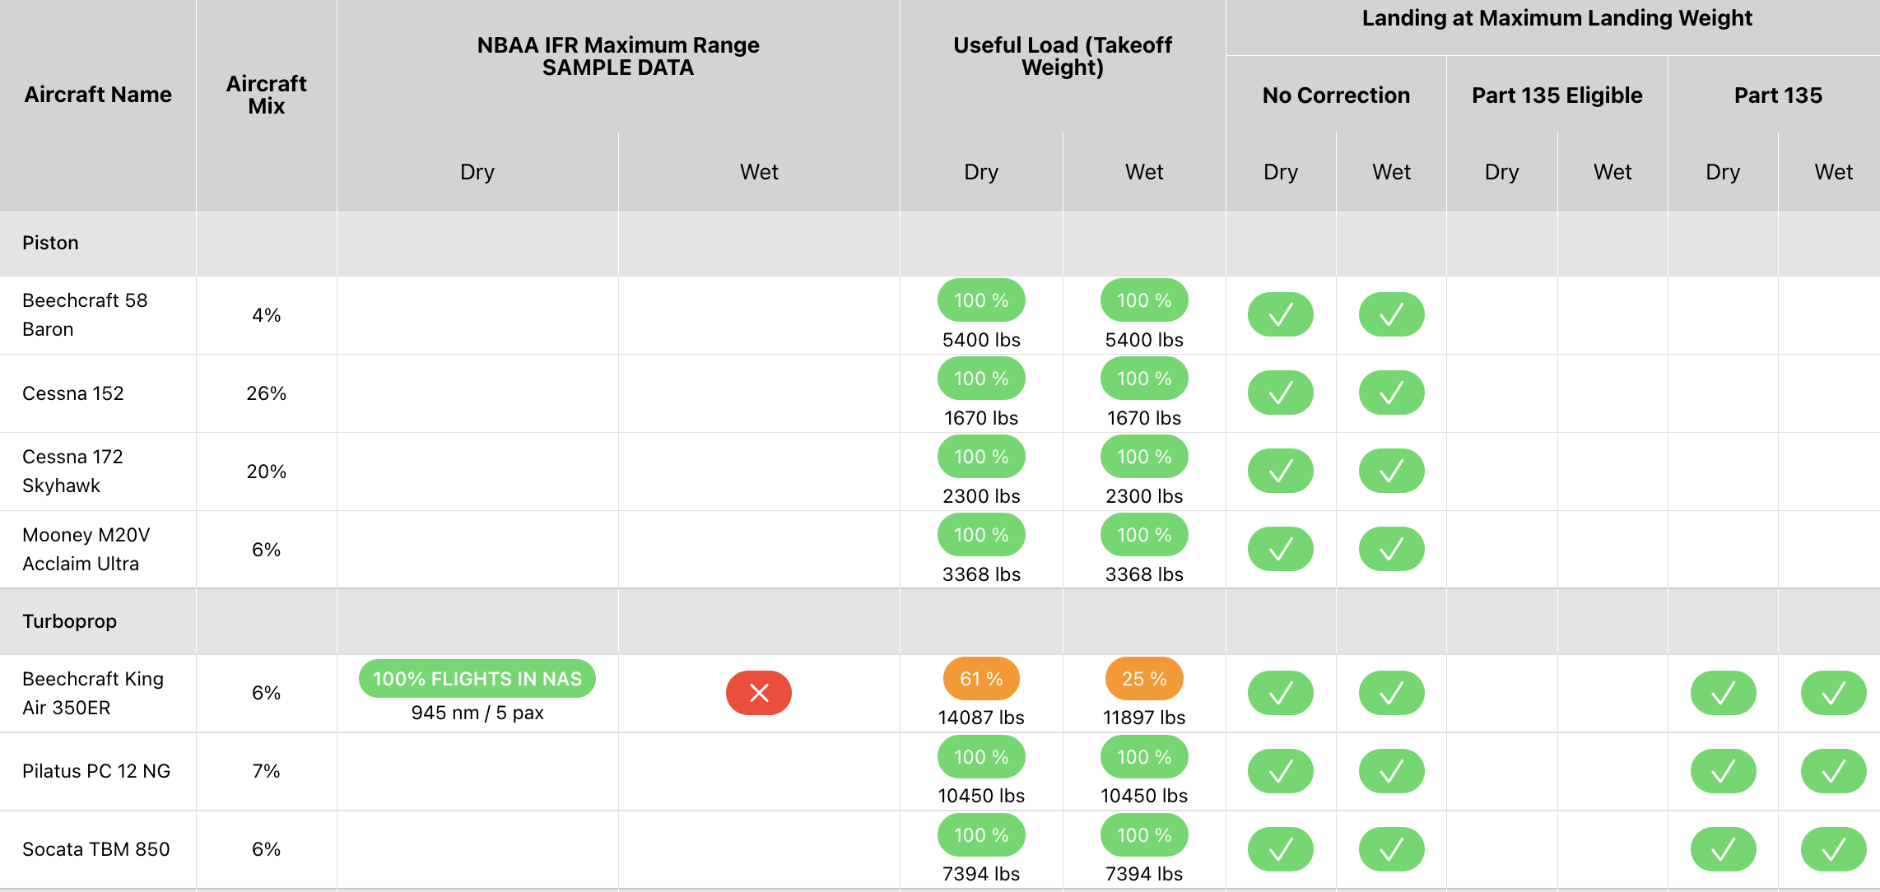
Runway Evaluation Results for Piston and Turboprop Aircraft
Go to Table of Contents
Observations:
All piston aircraft can operate at 100% useful load from the 5,200-foot runway
The King Air B350ER can operate at 61% useful load from a 5,200-foot dry runway
The King Air B350ER can operate at 25% useful load from a 5,200-foot wet runway (impractical)
The “x” mark under range for the King Air B350ER reports a limited aircraft range that is impractical.

Slide 78
Runway Evaluation Results for Jet Aircraft
Go to Table of Contents
Observations:
Three jets operate with useful load limitations from the 5,200-foot runway
The Bombardier Challenger 350 can operate at 39% useful load under wet pavement conditions
The “x” mark under the Part 135 columns indicate that landings are not feasible when accounting for the added landing runway length requirements of air taxi operations.

Slide 79
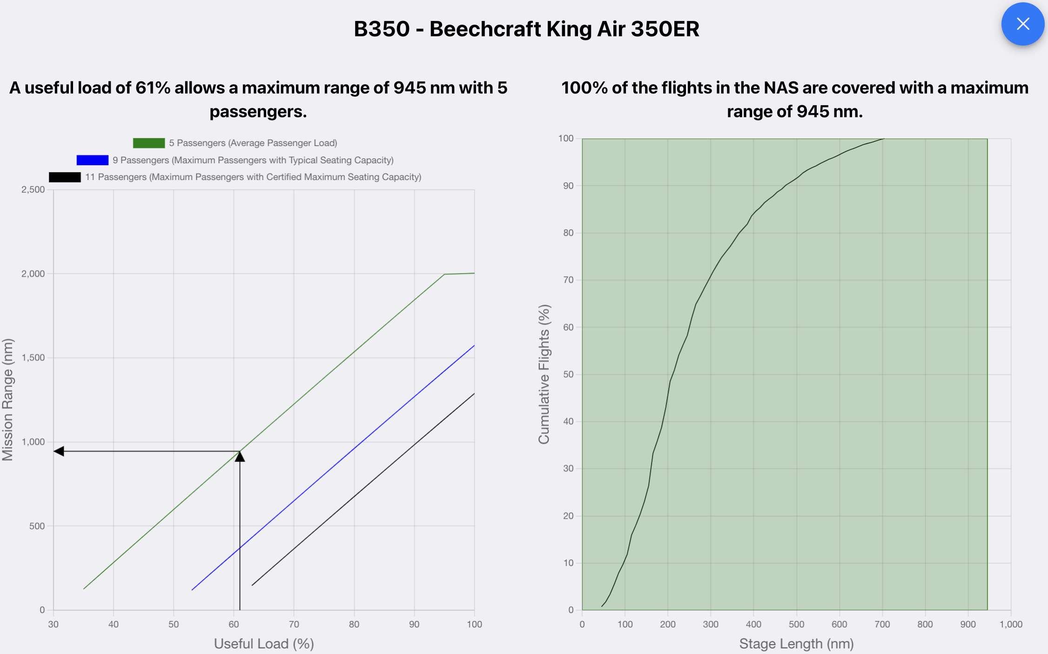
Interpretation of Useful Load Results for King Air B350ER
Go to Table of Contents
Probe deeper into the SARLAT 2 results by selecting individual aircraft that operate with significant useful load restrictions.
Click on the green area to explore the cumulative diagram of flights possible with five passengers plus two pilots and fly 945 nautical miles (with NBAA reserves)
A King Air B350ER can operate at 61% of its maximum useful load
The aircraft can takeoff at 14,087 lbs. and carry five passengers and travel 945 nautical miles
945 nm covers 100% of the flights conducted with the B350ER in the NAS.

Slide 80
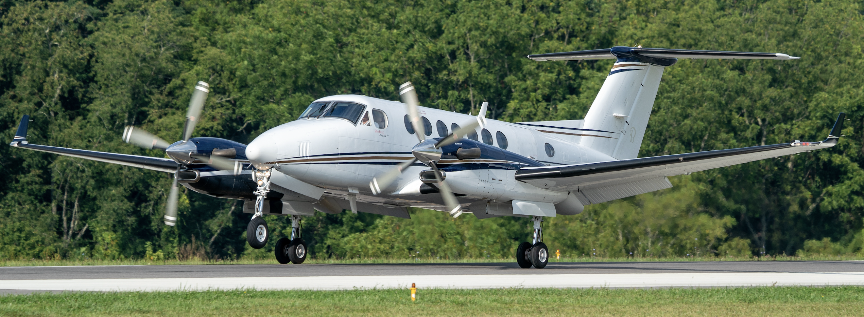
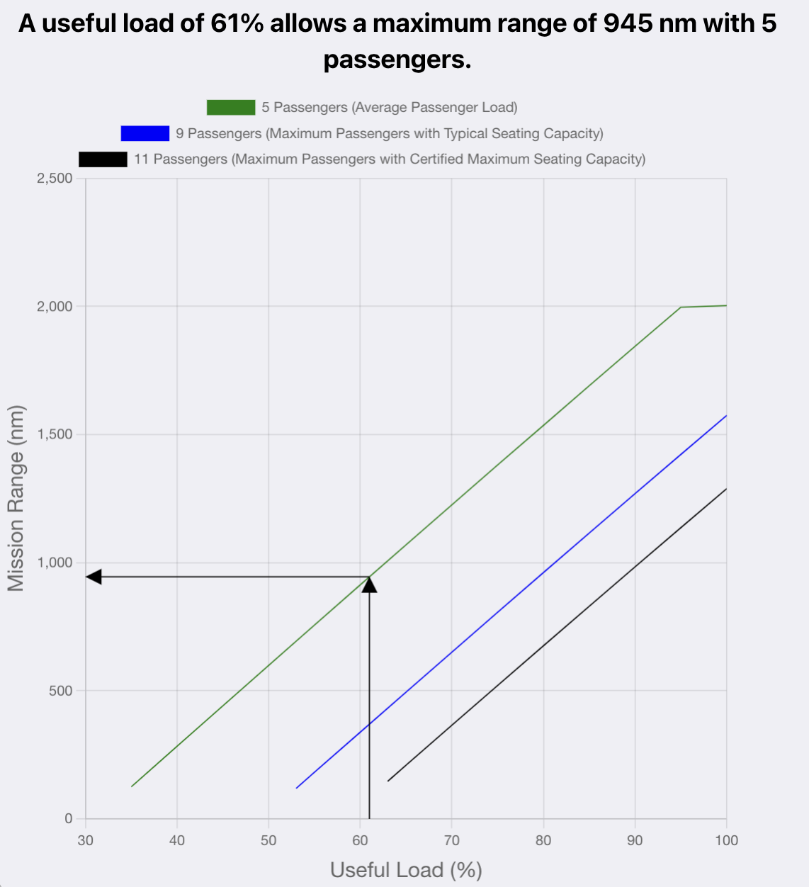
Useful Load and Mission Range for the King Air B350ER
Go to Table of Contents
A King Air B350ER can operate at 61% of its maximum useful load from the 5,200-foot runway (dry pavement)
The King Air B350ER takeoff field length is defined by the accelerate-stop-distance (certification basis is FAR Part 23 Commuter Category)
The aircraft can takeoff at a weight of 14,087 lbs. and carry five passengers and two pilots and travel 945 nautical miles
If the aircraft carries 9 passengers and two pilots, the mission range is reduced to 380 nm

Slide 81
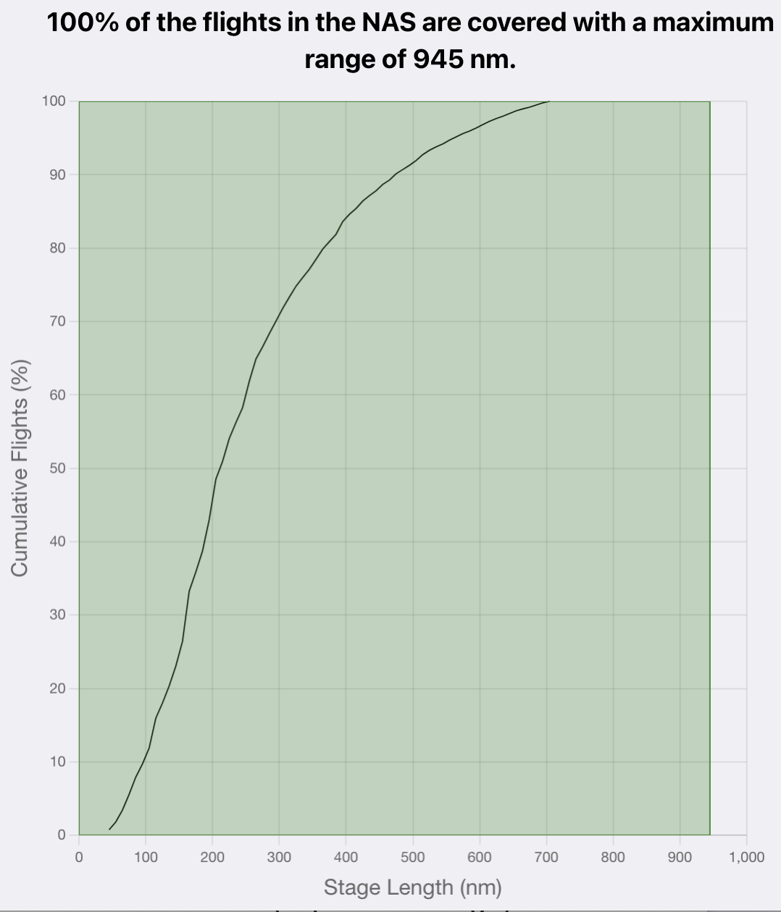
Mission Range and Trip Distances Flown for the King Air B350ER
Go to Table of Contents
A King Air B350ER can operate at a weight of 14,087 lbs. and carry five passengers plus two pilots and travel 945 nautical miles
The cumulative plot of flights for the King Air B350ER shows that a mission of 945 nm covers 100% of the flights conducted in the NAS
The King Air B350ER has a generous payload-range envelope making possible its operation from the 5,200-foot runway carrying typical passenger loads nearly 1,000 nautical mile.

Slide 82
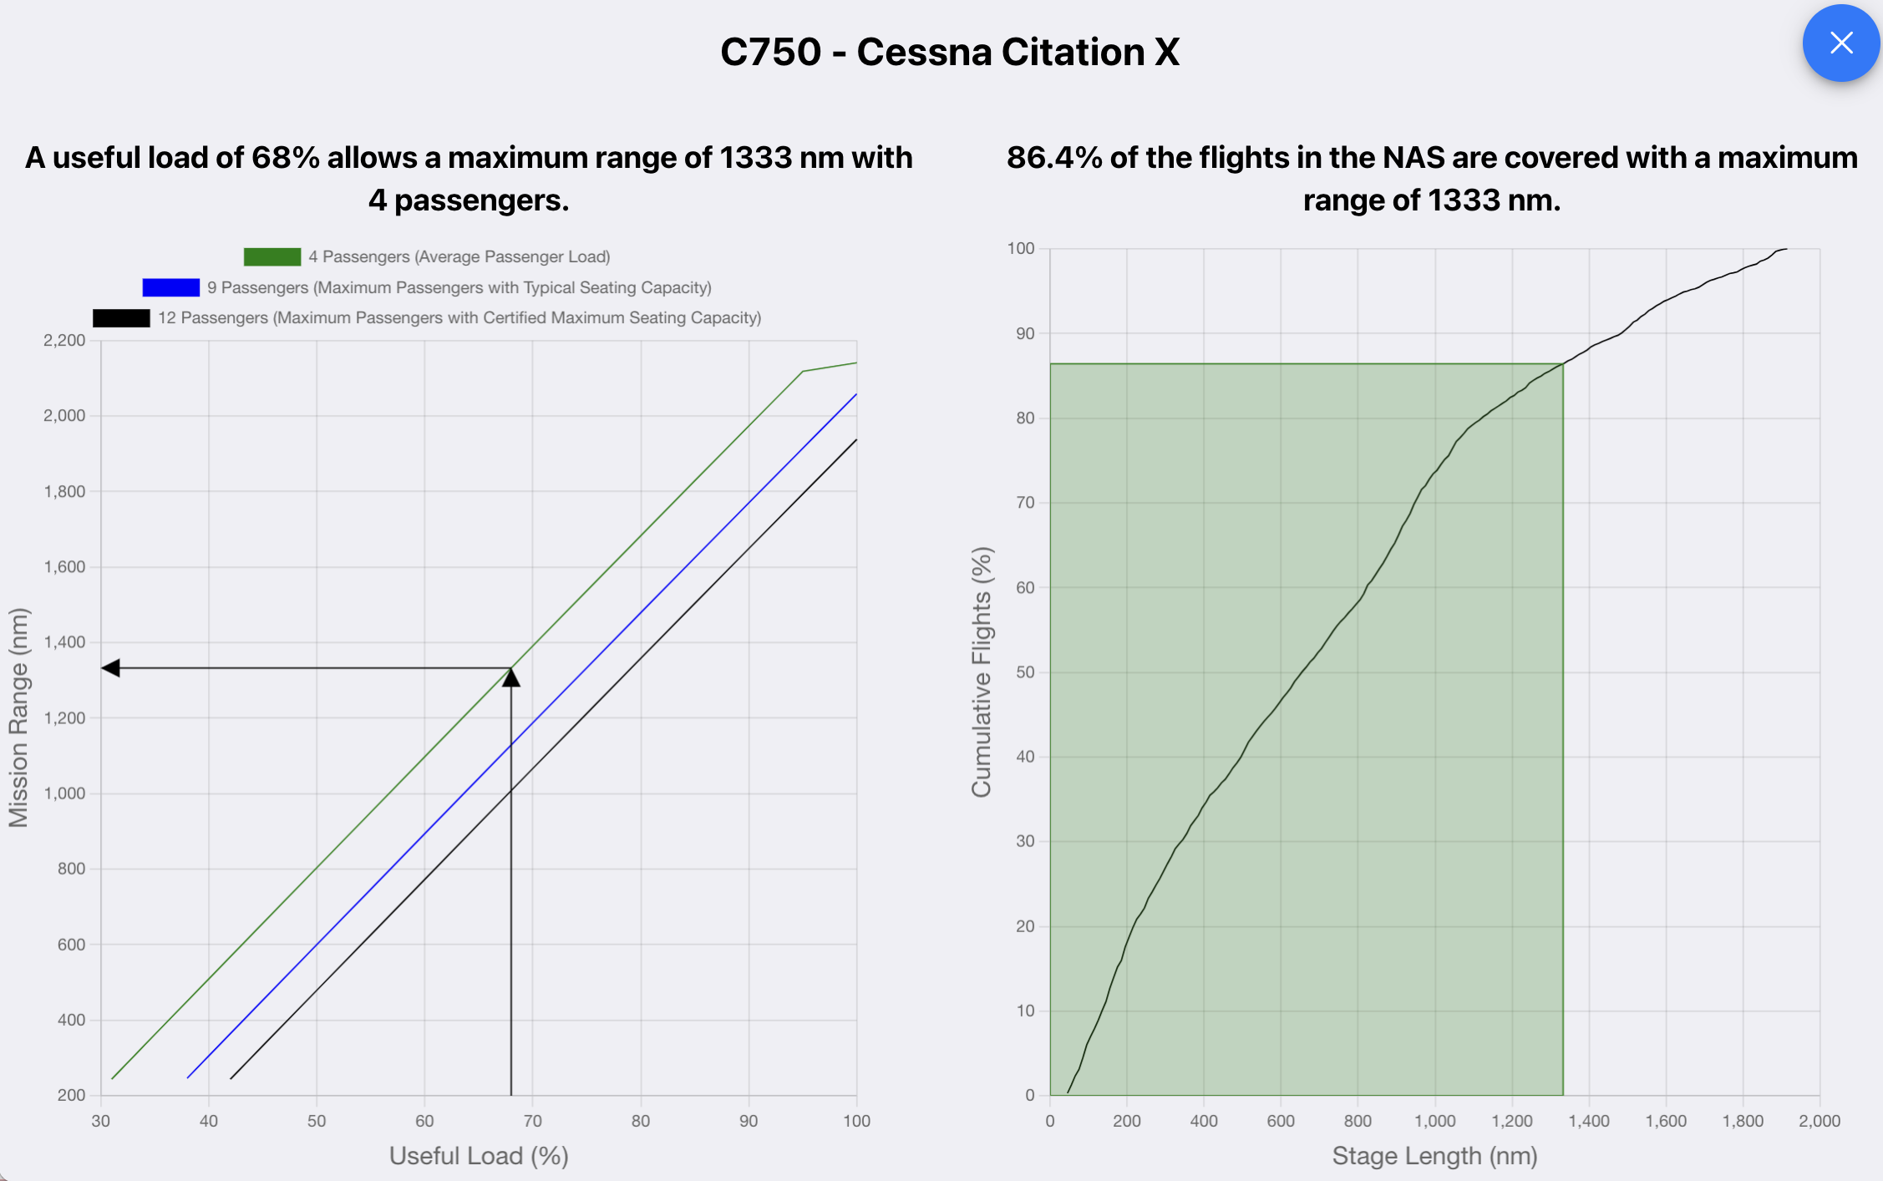
Interpretation of Useful Load Results for Cessna Citation X
Go to Table of Contents
Probe deeper into the SARLAT 2 results by selecting individual aircraft that operate with significant useful load restrictions.
Click on the green area to explore the cumulative diagram of flights possible with four passengers plus two pilots and fly 1,333 nautical miles (with NBAA reserves)
The Cessna Citation X can operate at 68% of its maximum useful load from the 5,200-foot runway (dry pavement)
The aircraft can takeoff at 31,661 lbs. and carry four passengers and travel 1,333 nautical miles
1,333 nm covers 86% of the flights in the NAS conducted with the Citation X

Slide 83
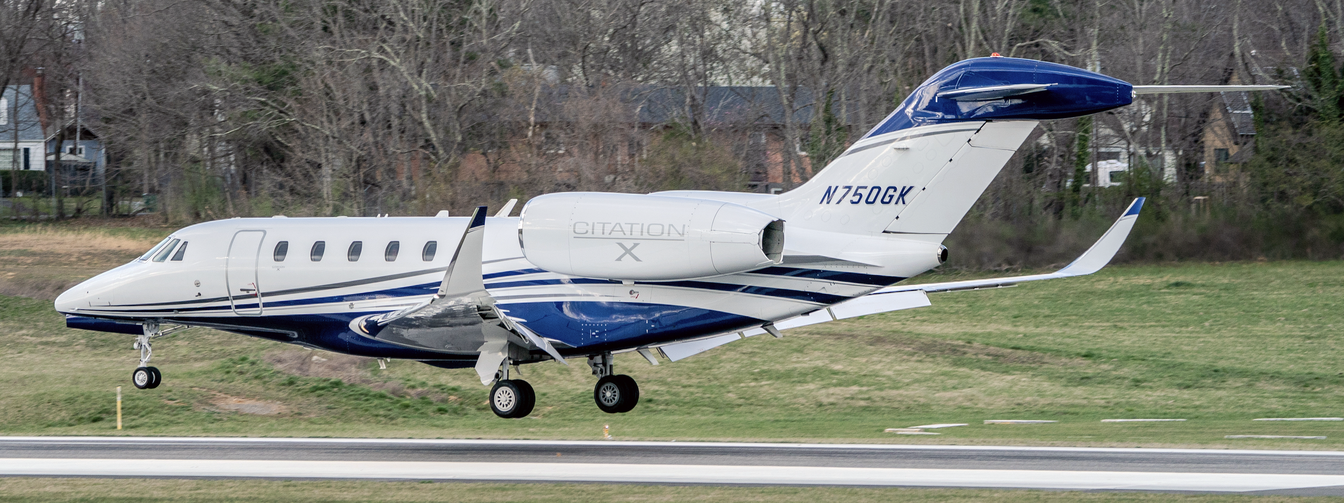
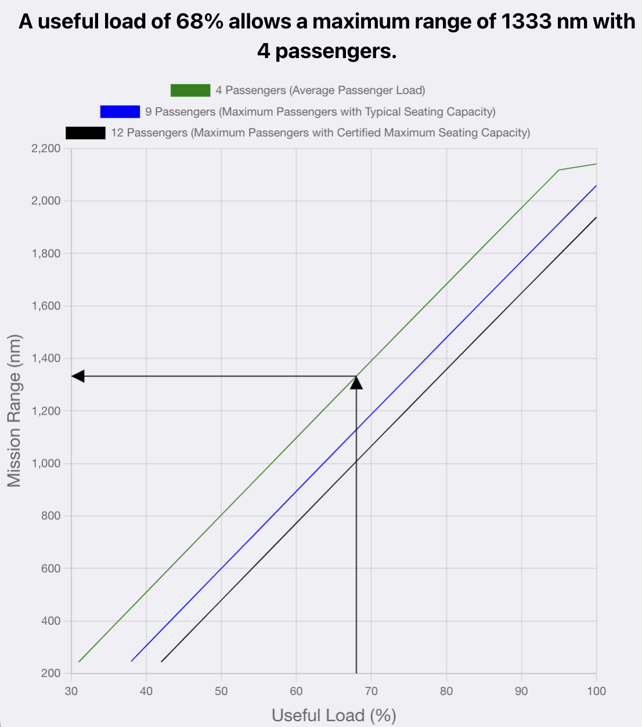
Useful Load and Mission Range for the Cessna Citation X
Go to Table of Contents
The Cessna Citation X can operate at 68% of its maximum useful load from the 5,200-foot runway (dry pavement)
The Cessna Citation X takeoff field length is either the accelerate-stop-distance or the single engine-out continued takeoff (certification basis is FAR Part 25)
The aircraft can takeoff at a weight of 31,661 lbs. and carry four passengers and two pilots and travel 1,333 nautical miles
If the aircraft carries 9 passengers and two pilots instead, the mission range is reduced to 1,120 nm

Slide 84
Mission Range and Trip Distances Flown for the Cessna Citation X
Go to Table of Contents
The Cessna Citation X can takeoff at a weight of 31,661 lbs. and carry four passengers and two pilots and travel 1,333 nautical miles
The cumulative plot of flights for the Cessna Citation X shows that a mission of 1,333 nm covers 86.4% of the flights conducted in the NAS
The cumulative flights versus stage length plot is obtained from thousands of flights obtained from the FAA TFMS-C system.

Slide 85
Interpretation of 14 CFR Part 135 Landing Results for the Cessna Citation X
Go to Table of Contents
The Cessna Citation X can take off and land on the 5,200-foot runway using actual (uncorrected) distances reported by the aircraft manufacturer
The uncorrected landing distances are 4,025 (dry) feet and 4,629 feet (wet)
The aircraft cannot land under 14 CFR Part 135 rules because adjustments to the landing distances by 1.67 and 1.92 are applied to the uncorrected dry and wet distances, respectively
For 14 CFR Part 135 rules under dry runway conditions, the runway requirement is 6,277 feet long.

Slide 86
Runway Evaluation Case Analysis Summary
Go to Table of Contents
The 5,200-foot runway seems acceptable for most of the aircraft in the fleet mix
Large turboprops like the King Air B350ER have a wide payload-range envelope allowing them to operate with five passengers and two pilots and still fly 100% of the missions flown in the NAS with a useful load of 61% from a dry 5,200-foot runway
Surprisingly, some very lights jets like the Cirrus Vision SF50 can operate with substantial useful load limitations if the 5,200-foot runway is wet (i.e., 68% useful load but only able to fly 235 nm with three passengers and a single pilot)

Slide 87
Providing Feedback to Improve the SARLAT 2 Tool
Go to Table of Contents
We welcome your feedback
Please contact:
Nick Hinze (nhinze@vt.edu)
Senior Research Associate
Air Transportation Systems Lab
or
Dr. Antonio Trani (vuela@vt.edu)
Director
Air Transportation Systems Lab

